Slide 1
Welcome to Year 2
Teachers: Mrs Baskerville and Mrs Bladon
Teaching Assistant: Mrs Harrop

Slide 2
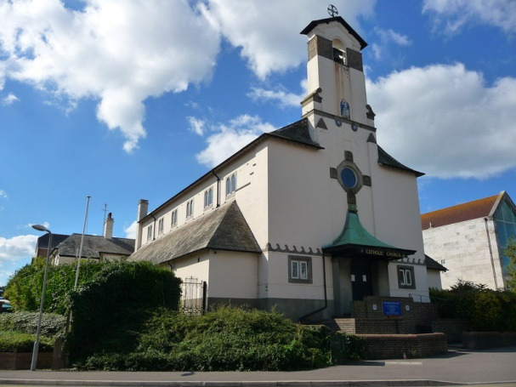
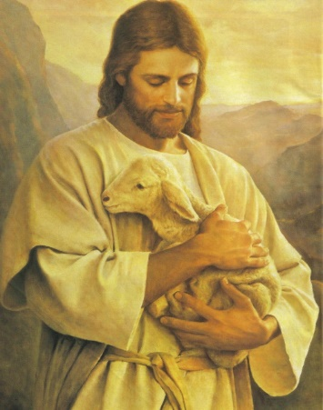
Catholic Life and Our School Mission Statement
The Catholic Life of our school is at the heart of everything we do.
Our school mission statement is our prayer.
‘Lead us Lord,
To Act Justly,
To Love Tenderly,
To walk humbly.
Amen.’
We ask the Lord to lead us in our relationships with one another and in to lead us in all our work at school.
We are proud to form part of Our Lady Star of the Sea Parish and work closely with Father Stephen and Deacon Geoffrey .
Our Catholic Life encompasses our work in RE and also the Worship Life of our school.

Slide 3
Our Gospel Values
Our Gospel Values are important to the Catholic Life of our school.
They are the qualities that underpin the way we approach our life at school.
Here are our Gospel Values displayed on our school certificates.
We start each week with a whole school Liturgy and during this worship time, focus on a gospel value to incorporate into our learning during that week. The children who demonstrate the gospel values are awarded Gospel Value certificates every two weeks and their achievements in relation to the values are rewarded in Celebration assembly.

Slide 4
Laudato Si’ – On Care for our Common Home
Laudato Si-On Care for the Common Home –
An Encyclical Letter from Pope Francis on Care for our World
We find opportunities through our topic teaching and through explicit RE lessons, to learn about, explore and discuss ways to care for one another and how we as caretakers of our world can learn to care for the environment. The children are encouraged to be mindful of the way they use resources responsibly and are careful in the way they consider energy use both at school and in their own homes.
Our curriculum is designed to allow children from Reception to Year 6 to consider how we all have a responsibility to care for our home, our planet, our common home.

Slide 5
Year 2 timetable
The school day starts between 8.40 and 8.55.
PE days – Tuesday and Friday
Every Friday, PE kits will be sent home for washing and must be returned on a Monday please
The school day finishes between 3 and 3.15pm.

Slide 6
Year 2 Topics
Term | Topic
Autumn 1 | Twisted Tales
Autumn 2 | Great Fire of London
Spring | The Circle of Life Dead or Alive Ape Conservation
Summer 1 | Recycle, Reuse, Reduce
Summer 2 | Around the World in Eighty Days Australia Africa India
Virtual meeting with the Fire Department!!
Trip to Monkey World!

Slide 7
Parents in Partnership and Home learning
PIPs and home learning will be available on the school website, in the new Year 2 tab at the top of the homepage, on a Friday and homework is expected to be back by the following Wednesday.
Home Learning English and Maths tasks will be set using an online platform called IXL.
Spellings will be included within the PIP letter.
Reading expectations – we aim for all children to be reading with an adult at least 5 times a week.

Slide 8
Reading at Home
At St Augustine’s we know that the development of early reading and writing skills are of paramount importance and children’s progress in reading and writing for the rest of their lives.
From the 14th September, children will be given a home reading folder. On the front cover will be your child’s name and the day of the week that their books will be changed.
In each folder children will have:
3 reading books at their stage of reading, for your child to read to you.
A library book to read for pleasure with you!
Their reading record
These books will be kept in your child’s folder for the week and changed on the day stated on the front of your folder. Children can still earn ‘reads’ for the Reading Challenge as they can read the same book more than once!

Slide 9
Rewards
House Points – Each child is allocated a ‘House Team’ this maybe red, blue, yellow or green. Children can be rewarded for their attitude to learning, behaviour and how they follow our Gospel Values.
Class Pasta Jar – children will work together to earn pasta pieces to gain a class reward at the end of each half term.
Celebration Assembly - During Friday Celebration Assembly your child may be awarded a certificate for effort, achievement or attainment.

Slide 10
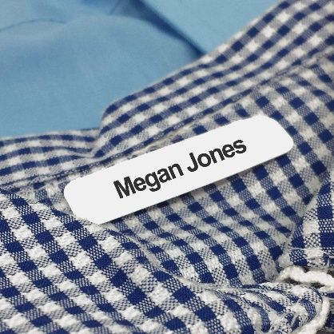
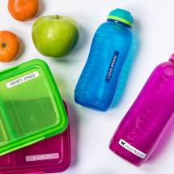
Uniform
You will see clear guidance on the school website on school uniform.
We ask that when you send your child to school in Autumn, you have every item of School uniform clearly named, including your child’s shoes.
As you can appreciate, school uniform is expensive and when we teach the children become warm and need to take of their cardigan or jumper, or when they are dressing for PE, everything needs to be named.
Free School Meals, Fruit and Drinks
Children in Year 2 are all entitled to the Universal Free School Meal Scheme. Please ensure your order online at local food links and ensure this is completed with your child, so they are happy with the choices you have made.
If you choose to provide your child with a packed lunch, discuss the contents of the lunch with your child to avoid upset.
We provide your child with a piece of fruit for the afternoon, but we ask that you give them a named piece of fruit for the morning.
We also ask that your child has a clearly named drink bottle that they can drink from throughout the day.

Slide 11
SATs!!!!!!!!!
Please don’t panic!
May 2021
We will run a Parent Session after Christmas to inform you of all of the details

Slide 12
Communication
As you can appreciate it is extremely important for us to know the arrangements you set up
to have your child collected at the end of the day. If you know you will not be collecting your
child in person, inform us at the beginning of the day who you have arranged to collect your
child. If arrangements change during the day, please ring the school office.
The school phone number is
01305 782600.
If your child is absent, please inform us before school, either by Parent Mail or by leaving a telephone message. We need to know the reason for your child’s absence every day that they are away. Similarly, it is essential that we know of any medical conditions your child may have as soon as possible please.
Please use our new Year 2 Tab on the school website for Home Learning, letters and any other communication.

