Slide 1
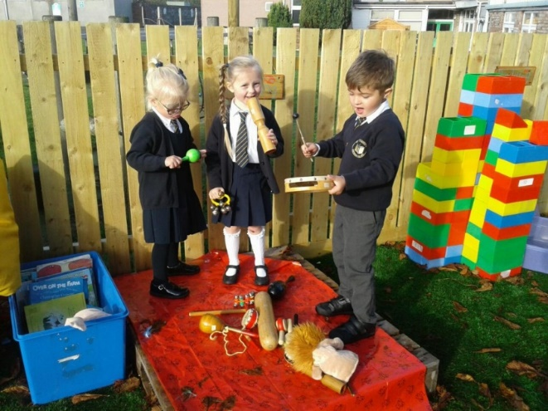
Welcome Presentation Summer 2020 St. Augustine’s Catholic Primary School
Background Information
We thank you for choosing to send your child to St. Augustine’s Catholic Primary School.
We welcome you and look forward to working with your family over the next 7 years.
St. Augustine’s School provides a nurturing and vibrant learning environment which we firmly believe provides our children with the qualities, skills and knowledge they need in their Primary education.
We have 1 Reception class with 30 pupils due to start with us in the Autumn Term.
Most of our children have attended Allsorts Preschool and some children from other
settings are coming to join us this year.
Having one class in Reception allows your child to get to know all the staff and other pupils quickly and this helps provide a friendly learning environment for your child making the transition from preschool to mainstream school seamless.
.

Slide 2
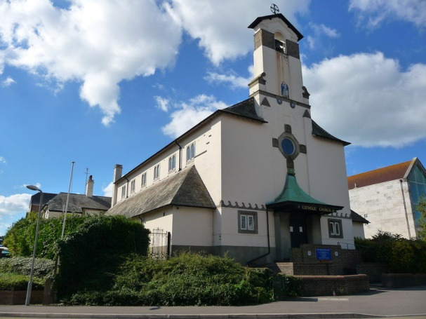
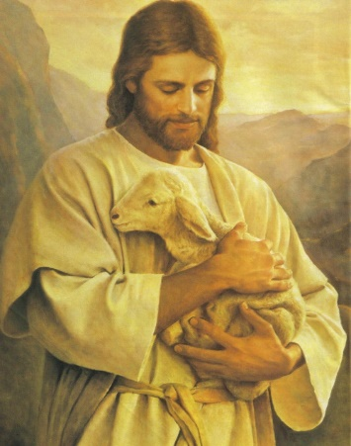
Catholic Life and Our School Mission Statement
The Catholic Life of our school is at the heart of everything we do.
Our school mission statement is our prayer.
‘Lead us Lord,
To Act Justly,
To Love Tenderly,
To walk humbly.
Amen.’
We ask the Lord to lead us in our relationships with one another and in to lead us in all our work at school.
We are proud to form part of Our Lady Star of the Sea Parish and work closely with Father Stephen and Deacon Geoffrey .
Our Catholic Life encompasses our work in RE and also the Worship Life of our school.

Slide 3
Our Gospel Values
Our Gospel Values are important to the Catholic Life of our school.
They are the qualities that underpin the way we approach our life at school.
Here are our Gospel Values displayed on our school certificates.
We start each week with a whole school Liturgy and during this worship time, focus on a gospel value to incorporate into our learning during that week. The children who demonstrate the gospel values are awarded Gospel Value certificates every two weeks and their achievements in relation to the values are rewarded in Celebration assembly.

Slide 4
Laudato Si’ – On Care for our Common Home
Laudato Si-On Care for the Common Home –
An Encyclical Letter from Pope Francis on Care for our World
We find opportunities through our topic teaching and through explicit RE lessons, to learn about, explore and discuss ways to care for one another and how we as caretakers of our world can learn to care for the environment. The children are encouraged to be mindful of the way they use resources responsibly and are careful in the way they consider energy use both at school and in their own homes.
Our curriculum is designed to allow children from Reception to Year 6 to consider how we all have a responsibility to care for our home, our planet, our common home.

Slide 5
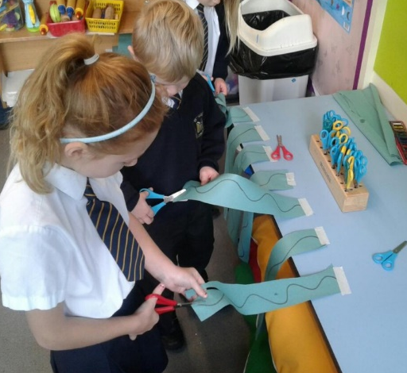
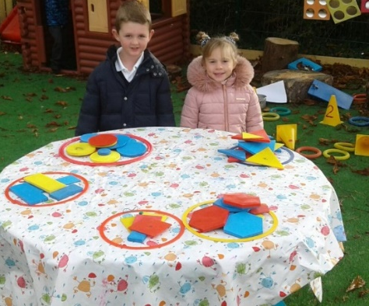
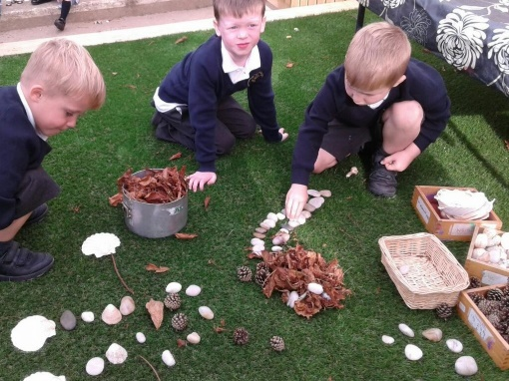
When your child starts school
The school day starts between 8.40 and 8.55.
A member of staff will greet you at the door and explain where you are required to place your child’s coat, PE kit, lunchbox and backpack (if they have one.)
The children will then bring their named fruit and named drink bottle into the classroom where they will go into a tray.
Every day onwards the children will carry their drink, fruit and book bag into the room.
The settling in period between 8.40 and 8.55 every morning when in the Autumn term, you may like to spend time with your chid as they come into the room. We ask that you leave at 8.55 as this is when we settle the children to start their learning.
Throughout your child’s day at school, they will continue to access
practical experiences as they did in preschool settings. The children continue to follow the Early Foundation Stage Curriculum with its focus on the children being active learners as they embark on child-initiated play situations as well as adult led learning.

Slide 6
Our Curriculum
A Creative Curriculum
Using Laudato Si’ as our curriculum driver, each year group incorporates a range of topics
which helps us teach about care for our common home, whilst also ensuring we teach our children
progressive key skills and knowledge.
This year in Reception 2019-2020, our topics were as follows:
Autumn 1 | Our Wonderful World
Autumn 2 | Helping Heroes
Spring 1 | Once upon a Time
Spring 2 | Take a Trip Around the World
Summer 1 | Get, Set, Grow
Summer 2 | Growing Up and Moving On.
For more information on how we teach Religious Education, English, Maths, Science, Information Technology ,Physical Education, History, Geography, Art, Design and Technology, Music and Personal, Health and Social Education in the Early Years, please look at the Curriculum section of your Welcome Pack in the New Parent’s Tab on the School Website.

Slide 7
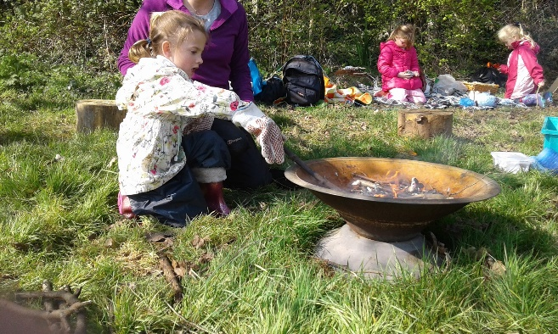
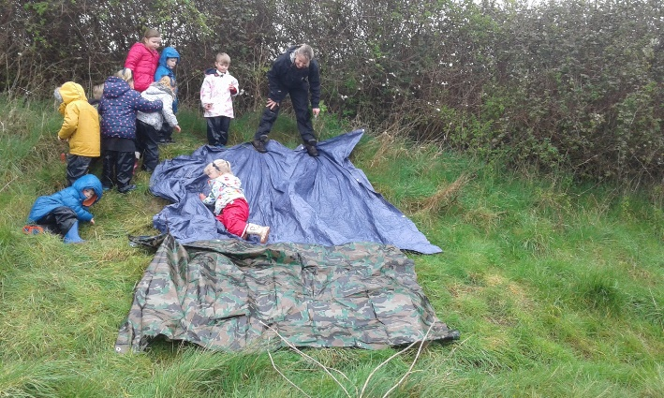
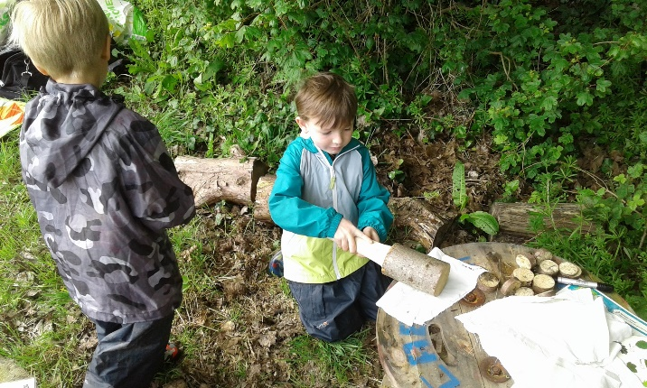
Forest School
A Creative Curriculum
As well as the curriculum opportunities we have already outlined, we are fortunate enough at St. Augustine’s School to have 2 members of Staff who are Forest School Practitioners.
During the year, the children are given outdoor learning opportunities and
have the opportunity to participate in Forest School activities.
Forest School teaches children many important life skills.
These include:
learning to work safely in the outdoors
learning to work as part of a team, problem solving,
caring for the environment
working with tools
using natural resources in an imaginative way.
The opportunities for making cross curricular links is endless and
our children in Reception really enjoy learning in the outdoor
environment.

Slide 8
Parents In Partnership
We believe that forming a strong partnership between Parents and School is fundamental in ensuring that children receive the best possible provision in their primary education.
We work hard at St. Augustine’s School to involve parents in every part of the children’s learning journey.
To help us in this work, communication is key and so every week teachers provide parents with a ‘PIP’ (Parents in Partnership) Newsletter/Task.
In Reception this weekly newsletter informs parents of upcoming events or to say thank you for support for particular school events and also provides information about what has been studied during the previous week.
Practical tasks are then provided to help parents support their children’s learning.
These tasks complement the children’s home/school reading programme (details of which are on the next slide.)
Please follow the following link to see an example of the PIP Newsletter.
file:///C:/Users/JudithE/Downloads/Spring_2_Week_2.pdf
The PIPs are given on a weekly basis, printed out and placed in the children’s reading book bags, but are also available on the school website so that if you misplace a letter or if your child is absent during a particular week, you can always access the letters.
We actively encourage parents to inform us of how their child has responded to a PIP Task either via Tapestry, our online Learning Journey (Information Slide later in this presentation) or via a note to us.
Parents in Partnership

Slide 9
The Home/School Reading Partnership
When your child starts at St. Augustine’s School, we give them a Reading Book Bag.
Inside the bag they are given 4 reading books to share with you throughout the week. You will be informed on which day of the week we change your child’s books. We will give you a reading record book which allows us and you to write how your child has responded to a particular book.
3 of the books will be from a Reading Scheme and will be of a level that we have assessed suits your child’s learning needs.
The 4th book will be a book that your child chooses from the class library and is purely chosen for enjoyment.
By working in this way, your child can share their books with you regularly during the week and by repeating a story, can learn it really well.
It also gives you the opportunity to focus on specific reading skills with your child such as
Storytelling, discussing characters and settings, predicting events, looking at particular letters and sounds being taught in class at that time and looking for ‘trick’ words.
We use ‘Story Time Phonics’ to help us teach phonics in reception and you may link to find out more about this scheme before your child starts school by following this link:
https://www.tts-group.co.uk/StoryTime+Phonics.html
We believe that teaching phonics using real books is an excellent
way for children to really engage and makes learning fun.

Slide 10
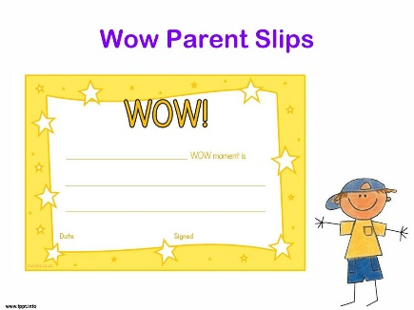
Celebration Time
Every day in Reception we have a ‘Celebration time.’
This time allows the children to share positive achievements with their class.
It’s lovely for us to celebrate the whole child by having positive contributions from home.
We ask you to become involved by either communicating home achievements on Tapestry (please see the next slide) or by writing ‘Wow’ slips.
Each morning, parents can write a ‘Wow’ slip about something that their child has achieved at home and pop the slip in our Wow Box.
Then at Celebration Time, the Wow Box is opened and we read the slips to the class.
We have had celebration time in reception for many years and the children really benefit from the positive response they receive from their class mates and staff.
Here are some examples of ‘Wow’ moments.
_______ learned to ride his/her bike with out stabilisers for the first time this weekend. | _________ helped plant some seeds with grandad at his allotment yesterday. | ___________ helped to lay the table for dinner last night.
Yesterday at dinnertime, ________ ate broccoli for the first time and liked it. | _____________ helped to look after his brother when he fell over yesterday. | ____________ has learned to swim with a float across the pool for the first time.

Slide 11
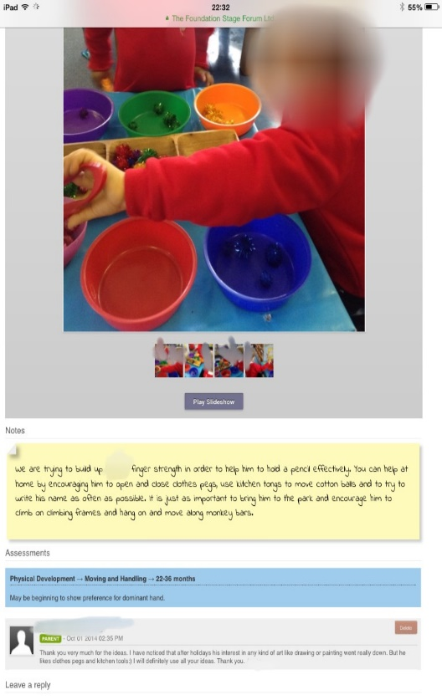
Tapestry
Tapestry is an Online Learning Journal that we use in the Reception Year at St. Augustine’s School. It allows us to work in partnership with parents as we record details of your child’s learning during their time with us. It is a website that can be accessed on a PC or Laptop computer or can be downloaded as an App and used on a tablet or Smartphone.
Tapestry enables Early Years Staff to upload photographs and observations of your child’s learning. You are then notified via an alert on your device that an addition has been made to your child’s Learning Journal. You can instantly access the observation and if you choose to, add a reply. The ease of the system allows us to also relate your child’s learning experiences to Learning Statements and Developmental Age Bands which you can instantly see, helping you see the progress your child is making in their 17 Areas of Learning. The example to the left shows a practitioner’s observation, the way it’s been related to the area of Physical Development in the 22-36 months age band and also a parent’s reply.
We have been using the Online Learning Journal for a year now and it has been an excellent tool for us as practitioners and also for our parents who have valued the direct involvement in their child’s learning.
We will be contacting you again in order to help you register on Tapestry, but in the meantime, if you’d like to learn more please go to: https://tapestry.info/parents-carers.html

Slide 12
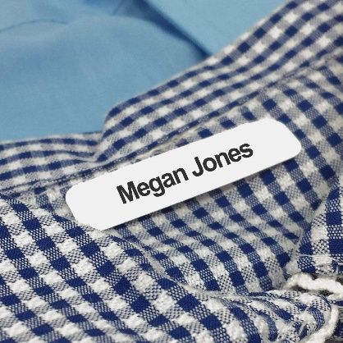
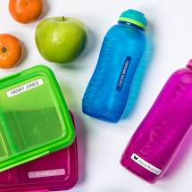
Uniform
You will see clear guidance in your Welcome pack on school uniform.
We ask that when you send your child to school in Autumn, you have every item of School uniform clearly named, including your child’s shoes.
As you can appreciate, school uniform is expensive and when we teach the children become warm and need to take of their cardigan or jumper, or when they are dressing for PE, everything needs to be named.
Please note that you will not need to buy your child a reading bag as FOSA (Friends of St. Augustine’s Group of Parents) provide these as a welcome gift to you.
We name these and give them to your child.
Free School Meals, Fruit and Drinks
Information about your entitlement to Free School Meals is in your Welcome pack. We ask that when you fill in your hot meal order form, you complete it with your child, so they are happy with the choices you have made.
If you choose to provide your child with a packed lunch, discuss the contents of the lunch with your child to avoid upset.
We provide your child with a piece of fruit for the afternoon, but we ask that you give them a named piece of fruit for the morning.
We also ask that your child has a clearly named drink bottle that they can drink from throughout the day.

Slide 13
Communication
As you can appreciate it is extremely important for us to know the arrangements you set up
to have your child collected at the end of the day. If you know you will not be collecting your
child in person, inform us at the beginning of the day who you have arranged to collect your
child. If arrangements change during the day, please ring the school office. The school phone number is
01305 782600.
If your child is absent, please inform us before school, either by Parent Mail (please see the Parent Mail Section in your
welcome pack,) or by leaving a telephone message. We need to know the reason for your child’s absence every day that
they are away. Similarly, it is essential that we know of any medical conditions your child may have as soon as possible please.
Your child’s reading book bag contains a Reading Record Book which also acts as a valuable form of communication. We expect you to check this every night in case of messages we need to give you or of important forms or letters.
We are available to discuss your child’s progress informally at a mutually convenient time and also hold termly Child/Parent/Teacher meetings to discuss your child’s progress. The dates of these meetings along with all significant dates in the Autumn term will be shared with you when your child starts school.
We thank you once again for choosing to send your child to St. Augustine’s School and we look forward to working with you and getting to know your child.
Please do contact us on the phone number above with any queries or for further information.

