Slide 1
Reception Class Presentation September 2020 St. Augustine’s Catholic Primary School
Thank you
We would like to take this opportunity to thank you for your support over the past few weeks in helping us welcome the children into Reception in such a smooth way.
We are delighted with the way the children are settling in and the way they’re accessing the indoor and outdoor learning environments so happily.
We will now go over some class routines and will provide you with some background information about the
School that we sent you in the Summer.

Slide 2
Communication
As you can appreciate it is extremely important for us to know the arrangements you set up
to have your child collected at the end of the day. If you know you will not be collecting your
child in person, please inform us at the beginning of the day who you have arranged to collect your child. If arrangements change during the day, please ring the school office. The school phone number is
01305 782600.
If your child is absent, please inform us before school, either by Parent Mail or by leaving a telephone message. We need to know the reason for your child’s absence every day that they are away.

Slide 3
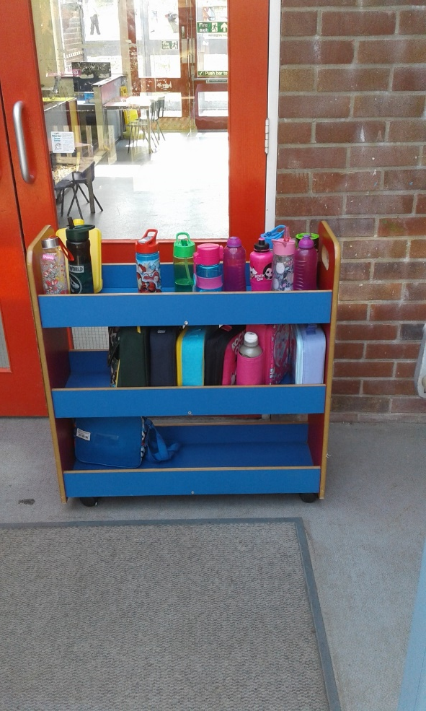
Reception Class Presentation September 2020
Morning Routine
In preparation for all the children in Reception being in full time attendance from Monday 21st September, we ask for your continued support in the morning.
When you prepare to leave your child with us at the red foundation stage area door, please help them take out their drink bottle, lunch box and named fruit from any bag they may have. Then, please help them place these items on our trolley and fruit break table, which will be positioned in the reception porch as shown in the photo. This then means that when the children are inside the entrance they will have minimal items to carry.
When the children are all in the room, we will then wheel the trolley inside so that the children can access their items when they need to.
PE Kits
We will continue to dress the children once a week for PE and they will then bring their kits home on a Friday. Please can you then return the kit on a Monday. Thank you.
Spare Clothes
Please can you provide your child with spare underwear in case they have a wetting accident if you feel your child needs it. This can then stay in a bag on their peg and be used when necessary.

Slide 4
Reception Class Presentation September 2020
Medical Conditions
Thank you for providing us with information regarding any medical conditions your child may have. If you are a parent that knows that your child has a medical condition such as asthma or food allergies that you have not directly communicated to us, please could you speak to us as a matter of urgency.
It is important that we are fully informed of such conditions and in receipt of inhalers that your child may be required to have during the school day.
Tapestry
Thank you for all registering on Tapestry. I am aware that some parents are not receiving notifications when a message/observation is sent through. If you have the Tapestry App, we ask you to revisit your settings and if necessary, change these to enable you to be alerted when you receive a message. If you do not have the app, please check Tapestry on a regular basis (perhaps once a week,) as we use Tapestry to help us effectively communicate with you about your child’s learning in school. Tapestry also allows you to respond to messages and observations directly, thus helping strengthen the link between home and school.

Slide 5
Reception Class Presentation September 2020
Celebration Time
Every day in Reception we have a ‘Celebration time.’
This time allows the children to share positive achievements with their class.
It’s lovely for us to celebrate the whole child by having positive contributions from home.
This year we ask you to become involved by communicating home achievements on Tapestry .
We have had celebration time in reception for many years and the children really benefit from the positive response they receive from their classmates and staff.
Here are some examples of ‘Wow’ moments.
_______ learned to ride his/her bike with out stabilisers for the first time this weekend. | _________ helped plant some seeds with grandad at his allotment yesterday. | ___________ helped to lay the table for dinner last night.
Yesterday at dinnertime, ________ ate broccoli for the first time and liked it. | _____________ helped to look after his brother when he fell over yesterday. | ____________ has learned to swim with a float across the pool for the first time.

Slide 6
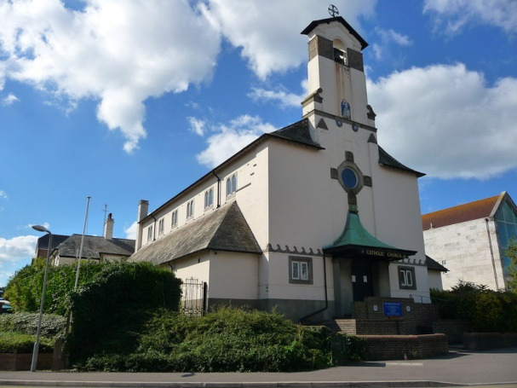
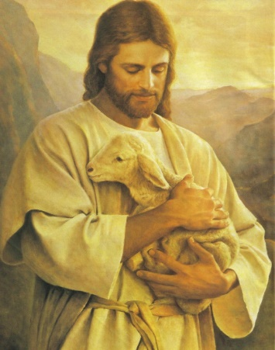
Catholic Life and Our School Mission Statement
The Catholic Life of our school is at the heart of everything we do.
Our school mission statement is our prayer.
‘Lead us Lord,
To Act Justly,
To Love Tenderly,
To walk humbly.
Amen.’
We ask the Lord to lead us in our relationships with one another and in to lead us in all our work at school.
We are proud to form part of Our Lady Star of the Sea Parish and work closely with Father Stephen and Deacon Geoffrey .
Our Catholic Life encompasses our work in RE and also the Worship Life of our school.

Slide 7
Our Gospel Values
Our Gospel Values are important to the Catholic Life of our school.
They are the qualities that underpin the way we approach our life at school.
Here are our Gospel Values displayed.
We start each week with a virtual whole school Liturgy and during this worship time, focus on a gospel value to incorporate into our learning during that week.

Slide 8
Laudato Si’ – On Care for our Common Home
Laudato Si-On Care for the Common Home –
An Encyclical Letter from Pope Francis on Care for our World
We find opportunities through our topic teaching and through explicit RE lessons, to learn about, explore and discuss ways to care for one another and how we as caretakers of our world can learn to care for the environment. The children are encouraged to be mindful of the way they use resources responsibly and are careful in the way they consider energy use both at school and in their own homes.
Our curriculum is designed to allow children from Reception to Year 6 to consider how we all have a responsibility to care for our home, our planet, our common home.

Slide 9
Our Curriculum
A Creative Curriculum
Using Laudato Si’ as our curriculum driver, each year group incorporates a range of topics
which help us teach about care for our common home, whilst also ensuring we teach our children
progressive key skills and knowledge.
This year in Reception 2020-2021, our topics are as follows:
Autumn 1 | Our Wonderful World
Autumn 2 | Helping Heroes
Spring 1 | Take a Trip Around the World
Spring 2
Summer 1 | Get, Set, Grow
Summer 2 | Growing Up and Moving On.
For more information on how we teach Religious Education, English, Maths, Science, Information Technology ,Physical Education, History, Geography, Art, Design and Technology, Music and Personal, Health and Social Education in the Early Years, please follow this link on the School Website. http://www.staugustines.dorset.sch.uk/website/early_years_curriculum/483603

Slide 10
The Home/School Reading Partnership
All of the children will have now received a Reading Book Bag.
Inside the bag they have 3 reading books to share with you throughout the week. We have informed you on Tapestry of the day when we change your child’s books. Please use the reading record book to write how your child has responded to a particular book.
2 of the books you have been given are from a Reading Scheme and are of a level that we have assessed suits your child’s learning needs.
The 3rd book is a book that your child chooses from the class library and is purely chosen for enjoyment.
By working in this way, your child can share their books with you regularly during the week and by repeating a story, can learn it really well.
It also gives you the opportunity to focus on specific reading skills with your child such as
storytelling, discussing characters and settings, predicting events, looking at particular letters and sounds being taught in class at that time and looking for ‘tricky’ words.
We use ‘Story Time Phonics’ to help us teach phonics in reception and you may link to find out more about this scheme before your child starts school by following this link:
https://www.tts-group.co.uk/StoryTime+Phonics.html
We believe that teaching phonics using real books is an excellent
way for children to really engage and makes learning fun.

Slide 11
PIP Newsletter
Every Friday we provide a Parents In Partnership Newsletter/Homework Task which we call a PIP letter for
short.
This PIP letter will be available on the Reception Page of the School Website.
http://www.staugustines.dorset.sch.uk/website/letters/504439
Every week it will keep you informed of curriculum work in the classroom and will also include tasks that you can work on with your child at home.
The tasks will be largely practical and your child’s response to the tasks could be fed back to us using Tapestry.
We can then celebrate the tasks during our Celebration Time. We look forward to how the children cope with these home learning tasks.
We look forward to continuing to work with you this year and please contact us if you have any queries or need clarification on any points.
Thank you.
Mrs Evans, Mrs Wootton and Miss Smith.

