Slide 1
KNOWLEDGE ORGANISER Year 4 Amazing Amazon

Slide 2
Curriculum Intent Statement -
At St. Augustine's Catholic Primary School, we are passionate about children's learning. The Cognitive Load research theory and Rosenshine’s Principles of Instruction highlights that children learn through remembering and recalling and this theory is embedded this within our curriculum.
‘Learning is Remembering and Recalling...’
Our curriculum is planned and sequenced around the specific vision of the National Curriculum, our Curriculum Drivers, the Laudato Si and the Gospel Values. This is based upon our School Catholic Mission that we have a moral purpose for our pupils to flourish in a safe, happy and stimulating environment, and leave us with the knowledge and skills, personal qualities and aspirations, to make the world a better place, inspired by the Gospel. We believe that this core belief underpins everything we do here at St. Augustine's.
St. Augustine’s curriculum will provide inspiring and relevant learning opportunities for our children to develop the knowledge and skills that can be fluently applied across all subject areas. It will ensure that all children's individual needs and experiences are developed through local, national and global contexts.
In order for children to relate to their learning, topic areas will be carefully planned and supported through external visitors talking about their experiences, or class trips to supplement the children's learning.

Slide 3
Curriculum Development - Intent
LauDato Si, National Curriculum and Gospel Values
Using our Secrets to Success…
Rosenshine’s Principles of Instruction
Parents in Partnership and Knowledge Organisers
English
Reading
Writing
Phonics
Spelling
Punctuation
Grammar
Maths Arithmetic Fluency Reasoning Problem Solving
RE Knowledge & Understanding
Engagement & Response
Analysis & Evaluation
The Culture Team
History
Geography
French (MFL)
The Arts and Technology Team
Design Technology Art
Music
Computing
The Healthy Hearts and Minds Team
PE
Science
PSHE / RSHE
Being the ‘Best we can be’

Slide 4
Our Laudato Si key question this half term…
What can we do to preserve the rainforest?
Our Focus Gospel Values this half term are…
How do you show peace and compassion in what you do?

Slide 5
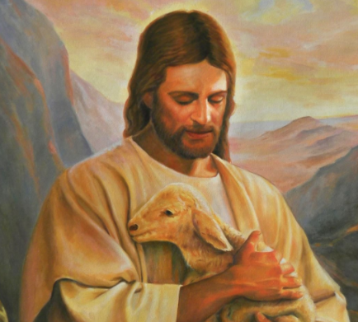
School Mission Statement
Lead us Lord,
To act justly,
To love tenderly,
And to walk humbly.
Amen

Slide 6
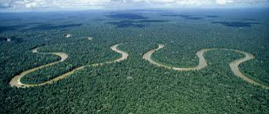
Amazing Amazon
This half term, Year 4 are learning about the Amazon rainforest, the animals that live in it, where in the world it is, what makes the Amazon so special and why it is in danger at the moment.
We have lots of exciting things planned, including:
Creating a vibrant Rainforest display linked to Henri Rousseau’s “Exotic Landscape” (1908).
Learning about a variety of Amazonian animals.
Practicing some salsa moves.
How can I help my child with this topic:
Ask them to tell you what they have done at school – have discussions about their learning.
Look up activities about the different layers of the rainforest.
Talk to your child about the damage being caused by deforestation .
Practice times tables together, make games out of it.
Take part in some of the topic grid homework tasks – this can be found on Google Classrooms.
The next few slides will show you some of the things that we will be covering within specific subjects. Each subject will look at a specific set of skills that will allow children to meet the National Curriculum objectives within Year 4.

Slide 7
English - KEY VOCABULARY
Spelling Key Vocabulary -
Compound Word - A word that contains two or more root words e.g. news+paper, ice+cream
Key Word/Common Exception Word - A word which can’t be phonetically decoded
Prefix - A prefix is added at the beginning of a word in order to turn it into another word e.g. disappear
Suffix - Suffix A suffix is an ‘ending’, used at the end of one word to turn it into another word e.g. teacher
Homophone - Two different words are homophones if they sound exactly the same when pronounced
e.g. hear/here
Grammar key vocabulary -
Pronoun - Word that takes the place of a noun e.g. it, he, she
Possessive Pronoun - Words that demonstrate ownership e.g. His, her
Verb - Verbs are sometimes called ‘doing words’ because many verbs name an action that someone does e.g. run, cook
Modal Verb - An auxiliary verb that expresses necessity or possibility e.g. might, should, will, must
Auxiliary Verb - A verb that helps make sense e.g. They have been swimming
Adverb - These modifying the verb e.g. quickly, happily
Adverbial - Linking ideas across paragraphs using adverbials of time [e.g. later], place [e.g. nearby] and number [e.g. secondly] or tense choices [e.g. he had seen her before]
Fronted Adverbial - Words or phrases at the beginning of a sentence, used to describe the action that follows e.g. Later that day, I heard the bad news
Question - Asks something e.g.: Why aren’t you my friend?
Statement - States a fact or something that has happened. E.g. You are my friend.
Command - Something you have to do. E.g. Be my friend!
Exclamation - When something is exclaimed- start with ‘what’ or ‘how’. E.g. What a good friend you are!

Slide 8
English
SPELLING
Words with a /shun/ sound, spelt with ‘sion’
Words with a /shun/ sound splt with ‘ssion’
Words with a /shun/ sound spelt with ‘tion’
Words with a /shun/ sound spelt with ‘cian’
Words with ‘ough’ to make a long /o/, /oo/ or /or/ sound
Year 3 and 4 CEW challenge.
Grammar
Noun Phrase - A phrase where an adjective is used before a noun to describe it e.g. blue table, fierce fox
Tense - Shows whether you are writing about the past, present or future
Relative Clause - Clauses that begin with who, which, where, when, whose, that, or an omitted relative pronoun
Subordinate Clause - Typically introduced by a conjunction, that forms part of and is dependent on a main clause (e.g. ‘when it rang’ in ‘she answered the phone when it rang’).
Direct Speech - The part being spoken e.g. Rachel shouted loudly “Watch out!”
Indirect / Reported Speech - Summarising what has been said e.g. He said they'd already eaten when he'd arrived.
Speech Marks - Punctuation used around the part being spoken e.g. The conductor shouted, “Sit down!”
READING Key vocabulary
Word meaning - Explaining the meaning of words in context and explaining how word choice enhances meaning.
Retrieval - Finding details and information from a text.
Prediction - Saying what will happen next or as a result of something.
Comprehension – understanding the text and how content is related to the meaning as a whole.
Inference - reaching a conclusion which you can explain and justify with evidence from the text.
Deduction - Using evidence in a text to support an idea.
HOW TO HELP - Reading
- Read with your child (lots)
- Discuss vocabulary and develop understanding of new words
- Visit local libraries
- Read comics/magazines/newspapers
- Let your child see you read
- Make reading enjoyable- not a battle
- Let children read what interests them
HOW TO HELP – Writing
Discuss descriptive techniques when reading.
Discuss how authors develop the plot in their stories.
Look at dialogue and how it moves a story on.
Encourage your child to write as much as possible for as many different purposes as you can.

Slide 9
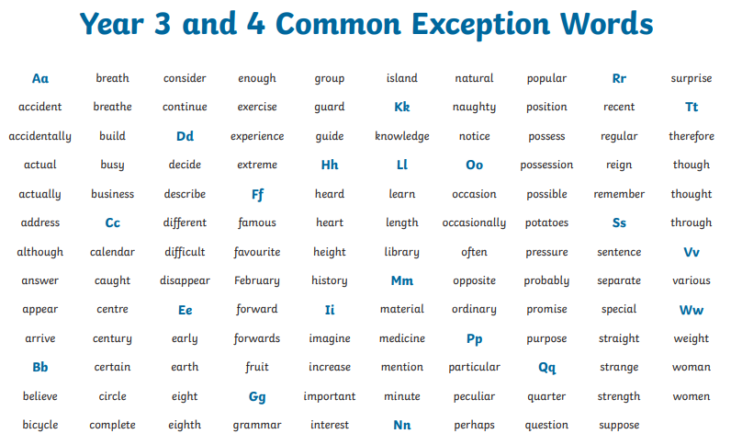
Spelling Y3 & 4 Common Exception words
Help your child to practice spelling and using these words.
Look for them in books.
Can they write them in their homework?

Slide 10
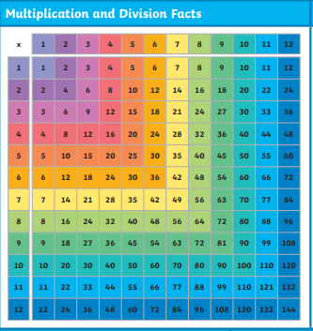
Maths – multiplication and division
This half term we are learning to :
Multiply and divide.
Measure area. Use and understand fractions.
TIMES TABLES – Are a vital part of school learning. Please support your child as much as possible with learning all their times tables.
HOW TO HELP
Mental arithmetic games – e.g. Countdown.
Regularly revisit times tables facts up to 12 x 12.
Use maths in daily life – cooking, measures, shopping etc.
Be positive about maths at home!
Embrace struggle! Teach your child that it’s good to get stuck! This is how we learn best. Allow time for resilience building.

Slide 11
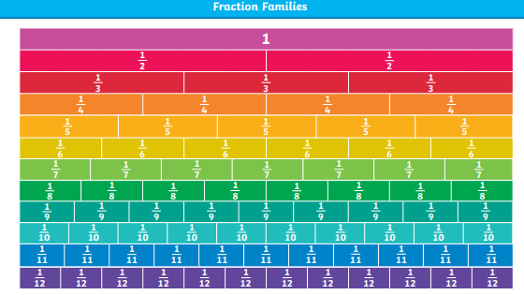
Maths – Fractions

Slide 12
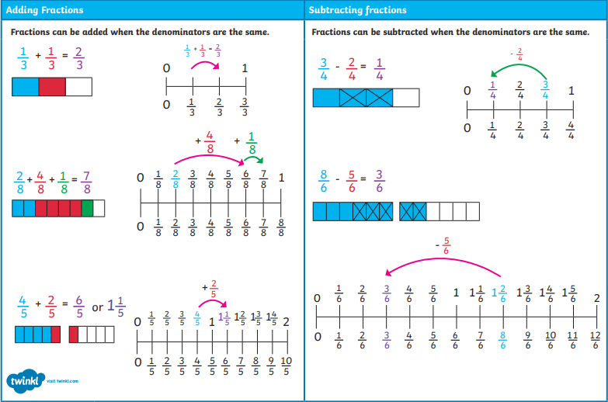
Maths – Fractions

Slide 13
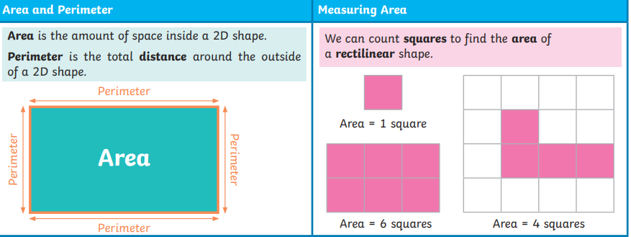
Maths – Area

Slide 14
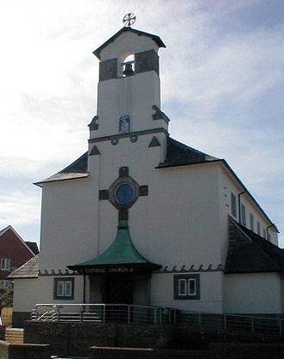
Religious Education
The Local Church and Community
The Local Church and Community - The experience of community is an essential and enjoyable part of life for people of every age and faith. The cycle of a year and the span of a lifetime contain occasions for regular celebrations as well as unexpected surprises, when people want to celebrate with family, friends and communities.
Key Questions
Think about your childhood. Which celebrations of community life did you most enjoy?
How did you celebrate? Who took part?
Which celebration are you looking forward to in the coming months?
How will you celebrate? Who else will take part?
Simeon celebrates the coming of Jesus of Nazareth. How do we celebrate his coming to us in Word and Sacrament?
What and how does your school community celebrate?
How do the adult members of your school community ‘work and plan together’ to make sure your religious celebrations involve the human values described?

Slide 15
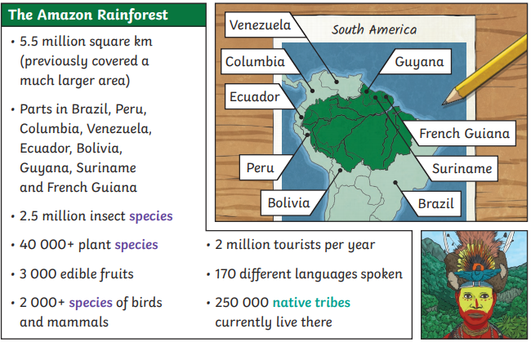
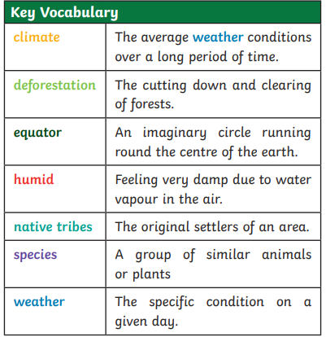
Geography

Slide 16
Geography

Slide 17
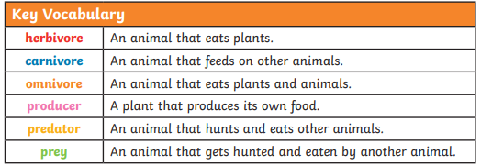
Science
Year 4 Skills:
Animals including Humans
Construct and interpret a variety of food chains, identifying producers, predators and prey.
Recognise that environments can change and that this can sometimes pose dangers to living things.

Slide 18
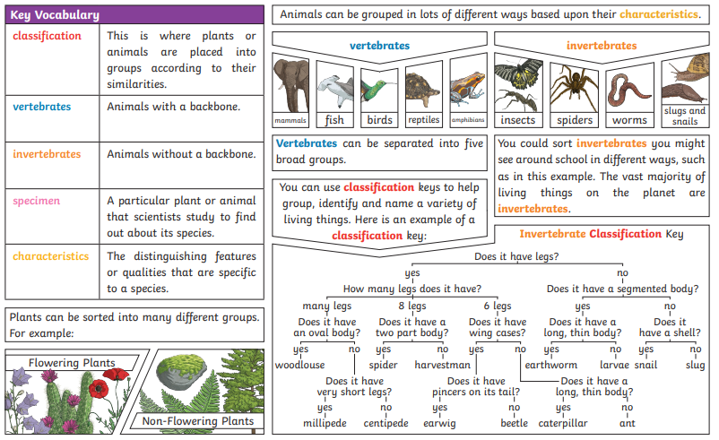
Science

Slide 19
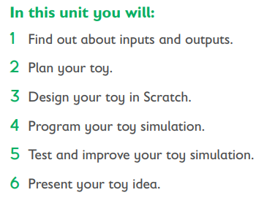
Computer Science
Rising Stars
We Are Toy Designers
Key vocabulary
Algorithm
Debug
Interactive
Prototype
Simulation
Output
Pitch
Input
Year 4 Skills:
-Design and make an on-screen prototype of a computer-controlled toy
-Understand different forms of input and output (such as sensors, switches, motors, lights and speakers)
-Design, write and debug the control and monitoring program for their toy.

Slide 20
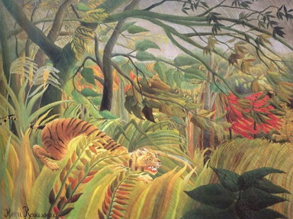
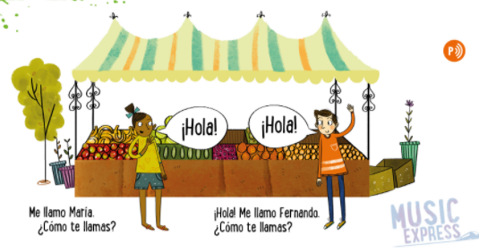
Art
Year 4 Skills
Generate ideas, considering the purposes for which they are designing
Make labelled drawings from different views showing specific features
Develop a clear idea of what has to be done, planning how to use materials, equipment and processes, and suggesting alternative methods of making, if the first attempts fail
Music
Musical focus: Pitch.
Henri Rousseau
Children will sample the sights and sounds of the Spanish speaking world as they learn greetings, count to 12 and play a singing game.
Select appropriate tools and techniques for making their product
Make informed choices in drawing inc. paper and media.
Alter and refine drawings and describe changes using art vocabulary.
Collect images and information independently in a sketchbook.
Use research to inspire drawings from memory and imagination.
Explore relationships between line and tone, pattern and shape, line and texture.
Year 4 Skills
Identify melodic phrases and play them by ear.
Create sequences of movements in response to sounds.
Explore and chose different movements to describe animals.
Demonstrate the ability to recognise the use of structure and expressive elements through dance.
Identify phrases that could be used as an introduction, interlude and ending.

Slide 21
PSHE
Valuing Difference
- Finding solutions to situations where people don't agree. The children will have some strategies and skills that they can apply when they find themselves in a similar situation.
- Explain/discuss the concept of ‘body space’ and feeling uncomfortable when people get too close. The uncomfortable feeling is the brain’s way of warning us.
- Consider the different types of relationships we can have with other people.
- What they think a friendly disposition might be. If someone behaves in such a way, how do you think it will affect their friendships?
What kind of behaviour might have the opposite effect and cause a person to struggle to make and keep friends?
- look at people from a range of different cultures living in this country and think about how important it is to respect everybody, even if their beliefs and practices are different from our own.
Stereotypes. A stereotype is when we think
one way of being fits all situations.
PE
Dance - Salsa
Year 4 Skills
Explore and create characters and narratives in response to a range of stimuli.
Use simple choreographic principles to create motifs and narrative.
Perform complex dance phrases and dances that communicate character and narrative.
Know and describe what you need to do to warm up and cool down for dance.
Describe, interpret and evaluate their own and others’ dances, taking account of character and narrative.

Slide 22
Foundation Subject IMPACT QUESTIONS
Geography – Where in the World are the rainforests found?
- Why are rainforests so important?
Science – How can we sort animals and plants into groups?
- How does an animals environment affect the life of the animal?
ICT – What is an example of an input and output?
- Can you give an example of how you debugged your toy?
PE – What are the counts used in Salsa dancing?
- Where does Salsa dancing originate from?
Art / Design Technology – How did you decide on the best material for the job?
- What is one fact you learnt about Henri Rousseau?
Music – What is the pentatonic scale?
- What is an example of tuned and untuned percussion we used?

