Slide 1
KNOWLEDGE ORGANISER Year 5 Spring Half Term 1

Slide 2
Curriculum Intent Statement -
At St. Augustine's Catholic Primary School, we are passionate about children's learning. The Cognitive Load research theory and Rosenshine’s Principles of Instruction highlights that children learn through remembering and recalling and this theory is embedded this within the knowledge of our curriculum.
‘Learning is Remembering and Recalling...’
Our curriculum is planned and sequenced around the specific vision of the National Curriculum, our Curriculum Drivers, the Laudato Si and the Gospel Values. This is based upon our School Catholic Mission that we have a moral purpose for our pupils to flourish in a safe, happy and stimulating environment, and leave us with the knowledge and skills, personal qualities and aspirations, to make the world a better place, inspired by the Gospel. We believe that this core belief underpins everything we do here at St. Augustine's.
St. Augustine’s curriculum will provide inspiring and relevant learning opportunities for our children to develop the knowledge and skills that can be fluently applied across all subject areas. It will ensure that all children's individual needs and experiences are developed through local, national and global contexts.
In order for children to relate to their learning, topic areas will be carefully planned and supported through external visitors talking about their experiences, or class trips to supplement the children's learning.

Slide 3
Curriculum Development - Intent
LauDato Si, National Curriculum and Gospel Values
Using our Secrets to Success…
Rosenshine’s Principles of Instruction
Parents in Partnership and Knowledge Organisers
English
Reading
Writing
Phonics
Spelling
Punctuation
Grammar
Maths Arithmetic Fluency Reasoning Problem Solving
RE Knowledge & Understanding
Engagement & Response
Analysis & Evaluation
The Culture Team
History
Geography
French (MFL)
The Arts and Technology Team
Design Technology Art
Music
Computing
The Healthy Hearts and Minds Team
PE
Science
PSHE / RSHE
Being the ‘Best we can be’

Slide 4
Our Laudato Si key question this half term…
Q: How can we show understanding for those around us?
Our Focus Gospel Value this half term is…
Yet the LORD longs to be gracious to you; therefore he will rise up to show you compassion. For the LORD is a God of justice. Blessed are all who wait for him! Isaiah 30:18

Slide 5
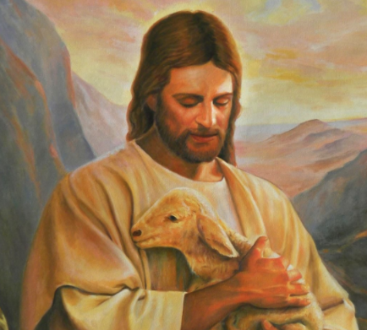
School Mission Statement
Lead us Lord,
To act justly,
To love tenderly,
And to walk humbly.
Amen

Slide 6
Celts, Anglo Saxons & the Vikings…
This half term Year 5 have lots of exciting things planned. We will be finding out about the different people’s that have made this island their home from around the birth of Jesus to 1066. Questions we will ask will include:
Were the Vikings really the bloodthirsty raiders many books and films have depicted them to be?
Why did the Anglo Saxons come to our island. Were they raiders, traders or both?
How have the Celts, Anglo Saxons and Vikings influenced the Great Britain of today?
How can I help my child with this topic:
Find out about local place names. Do any of them have a Celtic, Saxon or Viking root?
Look at the art produced by the Celts, Vikings and Saxons. What similarities and differences can you see in them?
Find out about the Saxon king, Alfred the Great. Who was he, what did he do and why is he important?
The next few slides will show you some of the things that we will be covering within specific subjects. Each subject will look at a specific set of skills that will allow children to meet the National Curriculum objectives within Year 5.

Slide 7
English Knowledge - KEY VOCABULARY
Grammar Key Vocabulary – Sentence Level
Progressive tenses – showing a continuous action e.g. is clapping, was jumping (formed by adding –ing to the verb).
Present perfect tense – used for actions that started in the past and continue into the present e.g. I have lived in Weymouth for 10 years (formed using has/have + past tense verb).
Adverbial phrases – describe how, when, where or why the verb happens e.g. in the garden, before school, at the park (adverbials at the start of a sentence must be followed by a comma).
Subject – the noun that is doing the verb e.g. The dog chased the ball.
Object – the noun that is having the verb done to it e.g. The dog chased the ball.
Active voice – the subject comes before the verb in a sentence e.g. The dog chased the ball.
Passive voice – the object comes before the verb in a sentence e.g. The ball was chased by the dog.
Grammar Key Vocabulary – Word Level
Preposition – describes when or where something is in relation to something else (after, before, under, inside).
Determiner – introduces a noun:
Articles (a, an, the)
Demonstratives (this, that, these, those)
Quantifiers (one, two, some, many, multiple)
Possessive (his, her, their)
Subordinating conjunction – a word that connects an independent clause to a dependent clause (because, although, however).
Co-ordinating conjunction – a word that joins two elements of equal importance (FANBOYS – for, and, nor, but, or, yet, so).
Synonyms – a word that means the same as another e.g. old and ancient.
Antonyms - a word that means the opposition – e.g. old and young.
Punctuation Key Vocabulary
Parenthesis ( ) , , - - additional information or an aside within a sentence. Punctuated with brackets (for short or formal information), dashes – for informal chatty – and commas for clauses.
Semi colon ; used to join independent clauses (clauses that make sense on their own) in the place of a conjunction.
Colon : used to introduce a list or to join two independent clauses when the second clause relates to the first.
Hyphens to avoid ambiguity used to avoid confusion between words which would otherwise have the same spelling but a different meaning.
Sentence Level Grammar Vocabulary
Decoding - Breaking down a word into different phonemes to help read it
Retrieval - Finding information from a text
Prediction - Saying what will happen next or as a result of something
Comprehension - Understanding what has been read
Inference - Making assumptions about what is happening in a text
Deduction - Using evidence in a text to support an idea
Don’t forget the Reading Challenge!

Slide 8
English Knowledge & Skills
SPELLING
Words with silent letters
Words ending in ment
Modal verbs
Adverbs of possibility and frequency
Statutory Spelling Challenge Words
Homophones – words that sound the same but mean different
WRITING - Short stories & Balanced arguments
AMPS descriptive techniques to describe setting, atmosphere and characters:
Alliteration – Most of the initial letter sounds of the words in each line are the same.
Metaphor – Saying an object is something.
Personification – A human quality is given to an object. Simile - Comparison is used by using ‘as a’ or ‘like a’.
Plot – developing problems and solutions within a story.
Dialogue – using the speech of characters to advance action in a story.
HOW TO HELP – Writing
Discuss descriptive techniques when reading.
Discuss how authors develop the plot in their stories.
Look at dialogue and how it moves a story on.
Encourage your child to write as much as possible for as many different purposes as you can.
READING Key vocabulary
Word meaning - Explaining the meaning of words in context and explaining how word choice enhances meaning.
Retrieval - Finding details and information from a text.
Prediction - Saying what will happen next or as a result of something.
Comprehension – understanding the text and how content is related to the meaning as a whole.
Inference - reaching a conclusion which you can explain and justify with evidence from the text.
Deduction - Using evidence in a text to support an idea.
Summary – summarising main ideas from across paragraphs.
Don’t forget the Vocabulary Challenge!
HOW TO HELP - Grammar
Speak in grammatically accurate sentences.
Spot gramma being taught at school when reading.
Work together on your child’s IXL homework.
HOW TO HELP - Reading
- Read with your child (lots)
- Discuss vocabulary and develop understanding of new words
- Visit local libraries
- Read comics/magazines/newspapers
- Let your child see you read
- Make reading enjoyable- not a battle
- Let children read what interests them

Slide 9
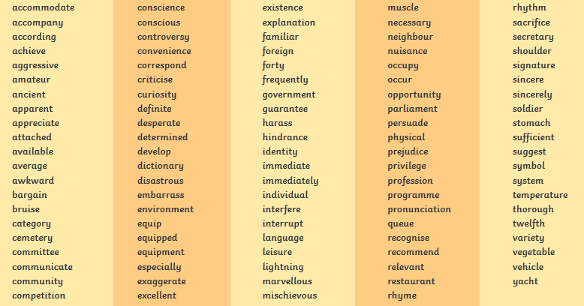
Spelling Y5 & 6 Curriculum words
Help your child to practice spelling and using these words.
Look for them in books.
Can they write them in their homework?

Slide 10
Maths Knowledge – KEY VOCABULARY
Number and the 4 Operations
Divisor – the number you are dividing by
Quotient – the answer to a division calculation
Product – the answer to a multiplication question
Factors – numbers that go into a given number (come in pairs) e.g. factors of 12 are:
1 and 12 2 and 6 3 and 4
Multiples – in the times table of - e.g. multiples of 12 are 12, 24, 36 etc.
Lowest Common Multiple – the lowest multiple of 2 or more numbers that are the same.
Highest Common Factor – the largest factor that is a factor of two or more other numbers
Integer – a whole number
Prime numbers – numbers that only have 2 factors, 1 and itself
Decimal – part of a whole where 1 is the whole
Percent – part of a whole where 100% represents the whole
HOW TO HELP
Mental arithmetic games – e.g. Countdown.
Regularly revisit times tables facts up to 12 x 12.
Use maths in daily life – cooking, measures, shopping etc.
Be positive about maths at home!
Embrace struggle! Teach your child that it’s good to get stuck! This is how we learn best. Allow time for resilience building.
IXL
TT Rockstars
Fractions
Equivalence – fractions that have the same value/are the same size
Numerator – the top number of a fraction (how many parts selected from the whole)
Denominator – the bottom number of a fraction (how many parts the whole is split into)
Simplify – giving a fraction in the simplest form using the smallest possible numerator and denominator (e.g. 50/100 = ½)
Common denominator – finding the lowest common multiple of two or more denominators to allow you to add or subtract them
Mixed number – a whole (integer) and a fraction e.g. 1 ½
Improper fraction – where the numerator is larger than the denominator e.g. 3/2. Improper fractions can be converted into mixed numbers e.g. 3/2 = 1 ½
Fluency, Reasoning and Problem Solving Key Vocabulary -
Fluency - Using number and calculation skills accurately and efficiently
Reasoning - Following a line of enquiry, justifying and proving their answers
Problem Solving - Solving real life and logical problems using mathematical understanding

Slide 11
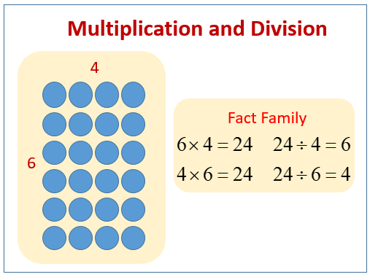
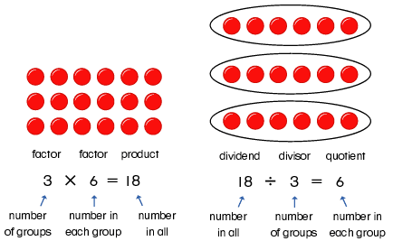
Maths – Multiplication & Division
This half term we are learning to :
-Multiply and divide numbers mentally drawing upon known facts. -Multiply numbers up to 4 digits by a one or two digit number using a formal written method, including long multiplication for 2-digit numbers. -Divide numbers up to 4 digits by a 1-digit number using the formal written method of short division and interpret remainders appropriately for the context. -Solve problems involving addition and subtraction, multiplication and division and a combination of these, including understanding the use of the equals sign.
-Identify multiples and factors, including finding all factor pairs of a number, and common factors of two numbers.
TIMES TABLES – the best possible help with both multiplying and dividing is knowing your times tables.

Slide 12
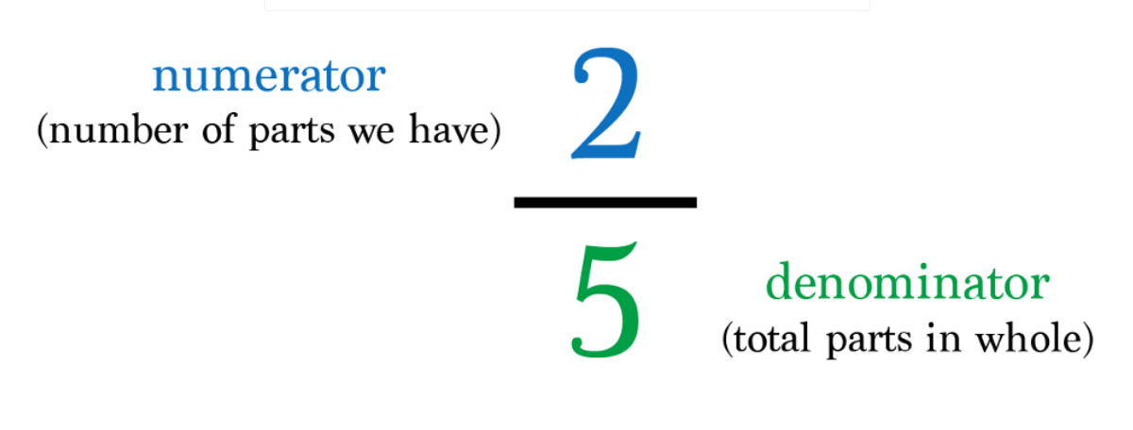
Maths – Fractions
-Compare and order fractions whose denominators are multiples of the same number. - Identify, name and write equivalent fractions of a given fraction, represented visually including tenths and hundredths. - Recognise mixed numbers and improper fractions and convert from one form to the other and write mathematical statements >1 as a mixed number [for example 2/5 + 4/5 = 6/5 = 1 1/5 ] - Add and subtract fractions with the same denominator and denominators that are multiples of the same number

Slide 13
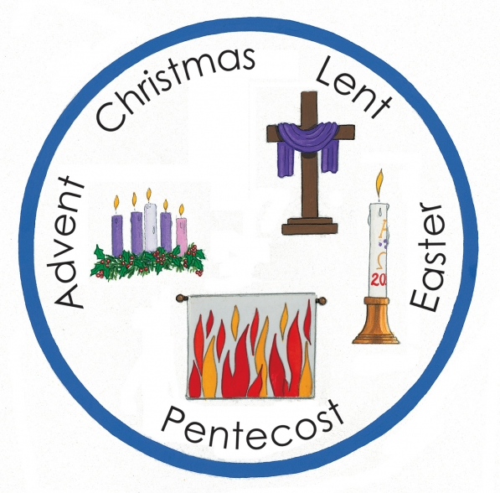
Religious Education
LOCAL CHURCH – COMMUNITY: MISSION: LIFE CHOICES
The Church, the Christian family, is made up of smaller Christian families called dioceses. Each diocese is led by a bishop. The bishops continue the work of ‘the twelve’, the apostles, who continued the work and mission of Jesus. Jesus is the head of these families. He is the head of the Church. There are other Christian families which are not part of the Catholic Church. Ecumenism is the word used for promoting unity among Christian churches. One of the final prayers of Jesus was that all Christian families might be one.
“The Spirit of the Lord is on me, because he has anointed me to proclaim good news to the poor. He has sent me to proclaim freedom for the prisoners and recovery of sight for the blind, to set the oppressed free, to proclaim the year of the Lord’s favor.”
Luke 4:18-19
What inspires people in their mission?
What are the joys and demands of engaging in a mission?
What unites Christian communities?

Slide 14
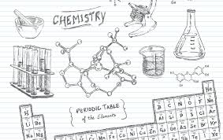
Science: Materials – Chemistry
This half term we will learn how to:
compare and group together everyday materials on the basis of their properties, including their hardness, solubility, transparency, conductivity (electrical and thermal), and response to magnets
know that some materials will dissolve in liquid to form a solution, and describe how to recover a substance from a solution
use knowledge of solids, liquids and gases to decide how mixtures might be separated, including through filtering, sieving and evaporating
give reasons, based on evidence from comparative and fair tests, for the particular uses of everyday materials, including metals, wood and plastic
demonstrate that dissolving, mixing and changes of state are reversible changes
explain that some changes result in the formation of new materials, and that this kind of change is not usually reversible, including changes associated with burning and the action of acid on bicarbonate of soda.

Slide 15
Celts, Anglo Saxons & the Vikings…

Slide 17
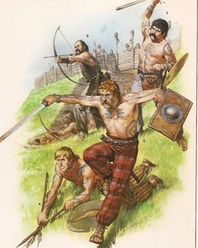
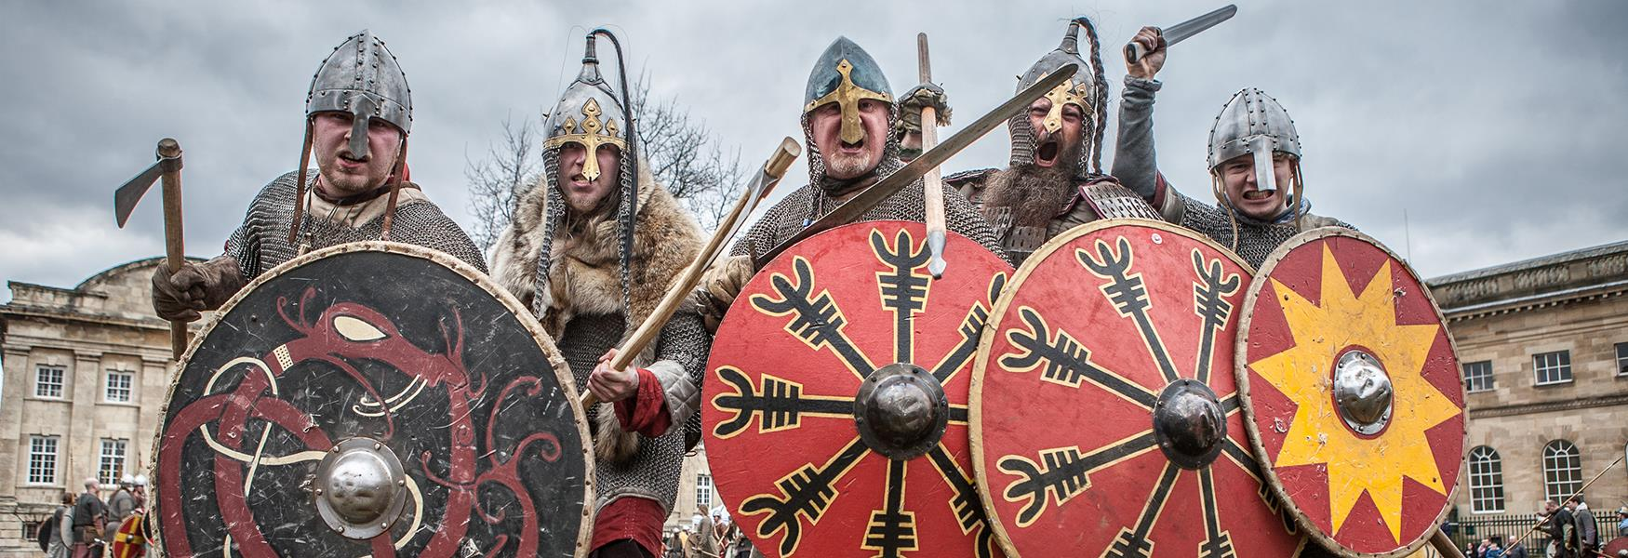
Celts, Anglo Saxons & the Vikings…
This half term we will be… -comparing accounts of events from different sources -offering some reasons for different versions of events -understanding that some evidence is unreliable -beginning to identify primary and secondary sources -using evidence to build up a picture of a past event -selecting relevant sections of information -using the internet for research -choosing reliable sources of evidence

Slide 18
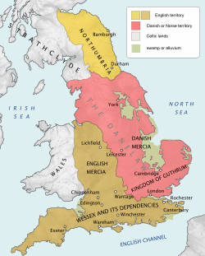
Geography
Celts, Anglo Saxons & Vikings in the British Isles
Year 5 Geography Skills:
We will be…
Comparing maps with aerial photographs.
Finding places on maps of different scales
Drawing a plan view map with some accuracy.
Analysing evidence and drawing conclusions e.g. compare historical maps of varying scales e.g. temperature of various locations - influence on people/everyday life

Slide 19
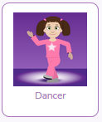
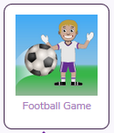
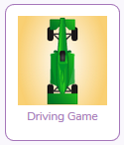
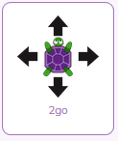
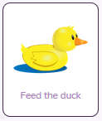
Computer Science – Communication
Year 5 Skills:
Children learn more about communicating information securely through an introduction to cryptography (the science of keeping communication and information secret). They investigate early methods of communicating over distances, learn about two early ciphers, and consider what makes a secure password.
•Understand the need for private information to be encrypted
•Encrypt and decrypt messages in simple ciphers
•Appreciate the need to use complex passwords and to keep them secure
•Have some understanding of how encryption works on the web

Slide 20
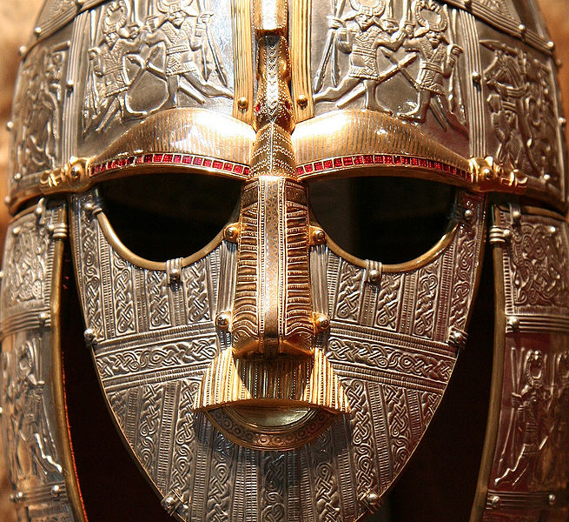
Art
Year 5 Skills
to generate ideas through brainstorming and identify a purpose for their product
to draw up a specification for their design
to develop a clear idea of what has to be done, planning how to use materials, equipment and processes, and suggesting alternative methods of making if the first attempts fail
to select appropriate materials, tools and techniques
to measure and mark out accurately
to use skills in using different tools and equipment safely and accurately
Music
Year 5 Skills
• Listening to music with focus and analysing using musical vocabulary
• Relating sound sequences to images
• Interpreting images to create descriptive sound sequences
• Understanding metre through singing and
playing instruments
• Conducting a metre of four
Key Vocabulary :
Process
Purpose
Product
Material
Tool
Technique
Accurately
Safely
Key Vocabulary
Arrangement
Metre
Lyric
Conducting

Slide 21
PSHE
PE
Dance
Objectives/ Skills
explore and improvise ideas for dances in different styles, working on their own, with a partner and in a group
compose dances by using adapting and developing steps, formations and patterning from different dance styles
perform dances expressively, using a range of performance skills
organise their own warm-up and cool-down activities to suit the dance
show an understanding of why it is important to warm up and cool down
describe, analyse, interpret, and evaluate dances, showing an understanding of some aspects of style and context
Year 5 this term will be learning about:
The facts about legal and illegal harmful substances and associated risks, including smoking, alcohol use and drug-taking.
Children will be learning how to:
recognise their increasing independence brings increased responsibility to keep themselves and others safe.
About people who are responsible
for helping them stay healthy and
safe; how they can help these
people to keep them healthy
and safe.

Slide 22
Foundation Subject IMPACT QUESTIONS
Topic/History
• Why do we study history? • What would happen if we did not learn about the past?
• Can we learn anything from the actions of people in the past?
Why were the Celts, Anglo Saxons and Vikings interested in our island?
PE
Why Is it important that we play team games?
How can we improve our ball skills?
Music
Can you explain what a
musical metre is?
Computing
How do you encrypt an email?
Is it possible to decipher a code?
How can we protect our identity online?
PSHE
Why are some activities illegal?
Why do lots of activities have a minimum age limit?
What would we do if we were offered something that is illegal?
Art
How can I make an accurate product from my design?

