Slide 1
KNOWLEDGE ORGANISER
Year 2

Slide 2
Curriculum Intent Statement -
At St. Augustine's Catholic Primary School, we are passionate about children's learning. The Cognitive Load research theory and Rosenshine’s Principles of Instruction highlights that children learn through remembering and recalling and this theory is embedded this within the knowledge of our curriculum.
‘Learning is Remembering and Recalling...’
Our curriculum is planned and sequenced around the specific vision of the National Curriculum, our Curriculum Drivers, the Laudato Si and the Gospel Values. This is based upon our School Catholic Mission that we have a moral purpose for our pupils to flourish in a safe, happy and stimulating environment, and leave us with the knowledge and skills, personal qualities and aspirations, to make the world a better place, inspired by the Gospel. We believe that this core belief underpins everything we do here at St. Augustine's.
St. Augustine’s curriculum will provide inspiring and relevant learning opportunities for our children to develop the knowledge and skills that can be fluently applied across all subject areas. It will ensure that all children's individual needs and experiences are developed through local, national and global contexts.
In order for children to relate to their learning, topic areas will be carefully planned and supported through external visitors talking about their experiences, or class trips to supplement the children's learning.

Slide 3
Curriculum Development - Intent
LauDato Si, National Curriculum and Gospel Values
Using our Secrets to Success…
Rosenshine’s Principles of Instruction
Parents in Partnership and Knowledge Organisers
English
Reading
Writing
Phonics
Spelling
Punctuation
Grammar
Maths Arithmetic Fluency Reasoning Problem Solving
RE Knowledge & Understanding
Engagement & Response
Analysis & Evaluation
The Culture Team
History
Geography
The Arts and Technology Team
Design Technology Art
Music
Computing
The Healthy Hearts and Minds Team
PE
Science
PSHE / RSHE
Being the ‘Best we can be’

Slide 4
Our Laudato Si key question this half term…
What causes extinction?
Our Focus Gospel Value this half term is…
How do you show humility in what you do?

Slide 5
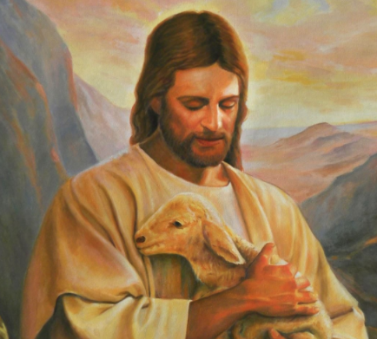
School Mission Statement
Lead us Lord,
To act justly,
To love tenderly,
And to walk humbly.
Amen

Slide 6
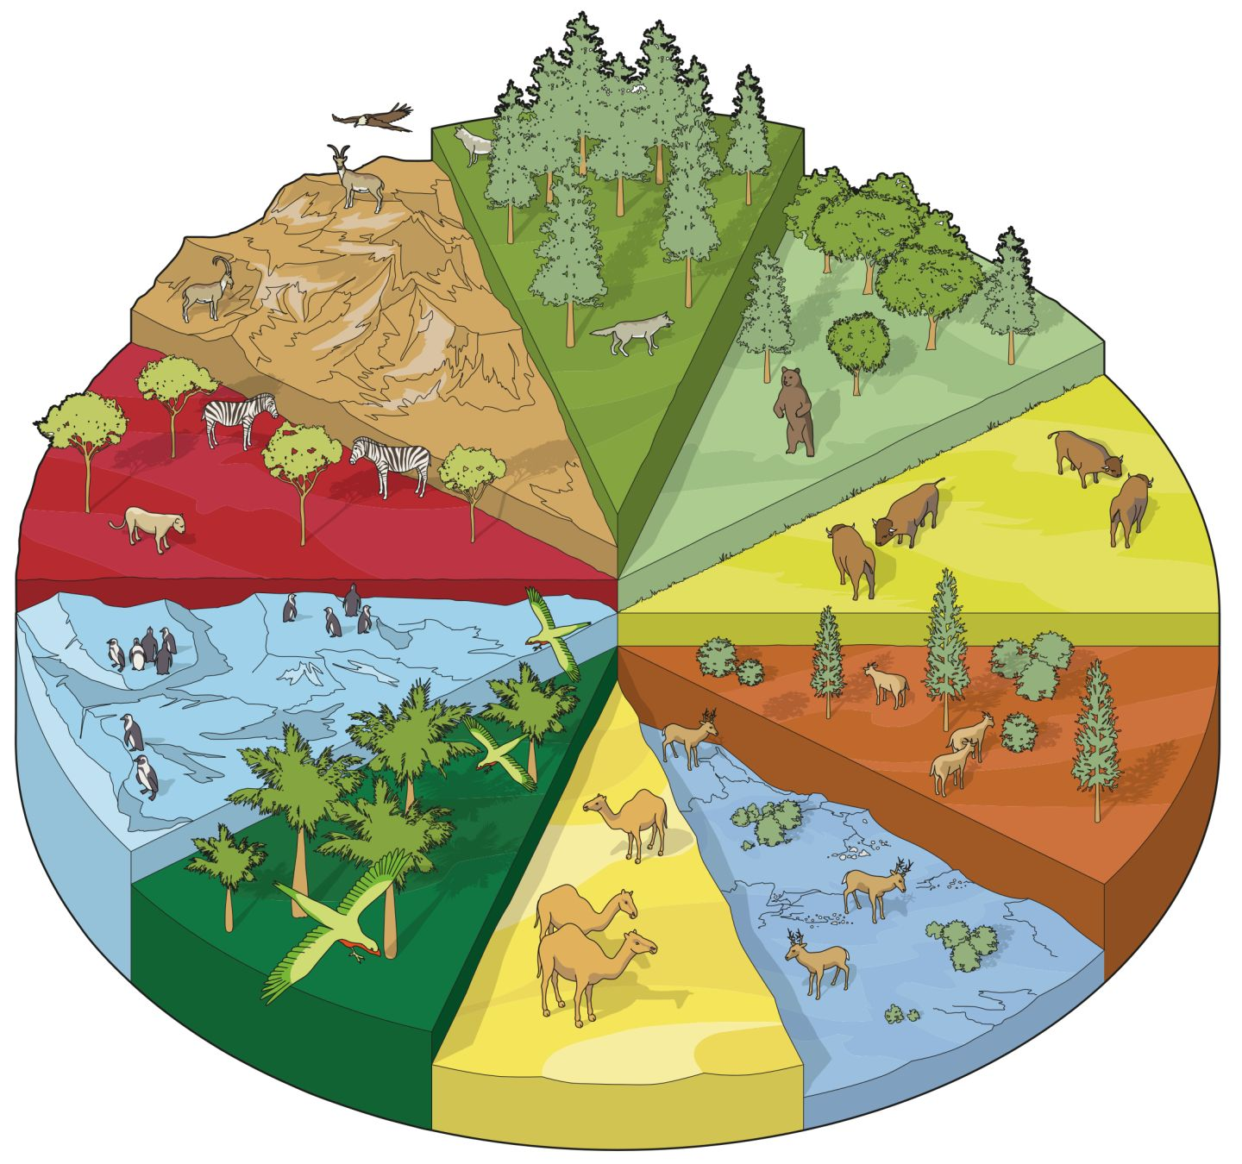
The Circle of Life
This half term, Year 2 are learning about The Circle of Life.
We have lots of exciting things planned, including:
Good quality texts to explore – Meerkat Mail, The Dancing Tiger and The Tiger Child.
Exploring our local habitat in science – we will look for minibeasts in our Forest School area!
How can I help my child with this topic:
Watch this video of The Tiger Child: https://www.youtube.com/watch?v=tVXgh9Dce-U
Watch the author of Meerkat Mail read her book here: https://www.youtube.com/watch?v=7lEigAZpusI
Visit Oak Academy to learn more about habitats here: https://classroom.thenational.academy/units/habitats-c850
The next few slides will show you some of the things that we will be covering within specific subjects. Each subject will look at a specific set of skills that will allow children to meet the National Curriculum objectives within Year 2.

Slide 7
English - KS1 KEY VOCABULARY
Phonics/Spelling Key Vocabulary
Phoneme - A single unit of sound
Diagraph - A type of grapheme where two letters represent one phoneme (sound) e.g. each
Consonants - Most of the letters of the alphabet represent consonants; the letters a, e, i, o, u represent vowels
Vowels - The letters a, e, i, o, u
Grapheme - A letter, or combination of letters, that corresponds to a single phoneme within a word e.g. ten
Segment - Break a word into phonemes
Blend - Put the phonemes back together
Compound Word - A word that contains two or more root words e.g. news+paper, ice+cream
Key Word/Common Exception Word - A word which can’t be phonetically decoded
Prefix - A prefix is added at the beginning of a word in order to turn it into another word e.g. disappear
Suffix - Suffix A suffix is an ‘ending’, used at the end of one word to turn it into another word e.g. teacher
Pseudo Word - Words use to check phonic decoding skills which are not real word eg meap
Homophone - Two different words are homophones if they sound exactly the same when pronounced
e.g. hear/here
Reading Key Vocabulary
Decoding - Breaking down a word into different phonemes to help read it
Retrieval - Finding information from a text
Prediction - Saying what will happen next or as a result of something
Comprehension - Understanding what has been read
Inference - Making assumptions about what is happening in a text
Deduction - Using evidence in a text to support an idea
Don’t forget the Reading Challenge!
Grammar Key Vocabulary
Adjective - Used before a noun to make the noun’s meaning more specific e.g. tall, blue
Noun - Nouns are sometimes called ‘naming words’ because they name people, places and ‘things’ e.g. table, hotel
Verb - Verbs are sometimes called ‘doing words’ because many verbs name an action that someone does e.g. run, cook
Adverb - These modifying the verb e.g. quickly, happily
Statement - States a fact or something that has happened. E.g. You are my friend.
Command - Something you have to do. E.g. Be my friend!
Exclamation - When something is exclaimed- start with ‘what’ or ‘how’. E.g. What a good friend you are!
Noun Phrase - A phrase where an adjective is used before a noun to describe it e.g. blue table, fierce fox

Slide 8
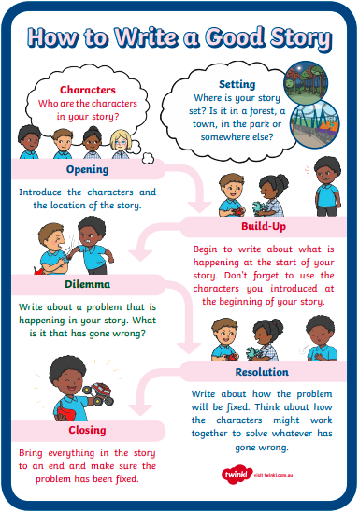
English - Knowledge
HOW TO HELP - Phonics/Spelling -
- Practise reading and spelling key words
- Use Read, Write Inc. Phonics sheets sent home
- Learn your child’s spellings with them
- Encourage writing spelling words in sentences
- Encourage your child to write stories and letters
- Help your child to spot patterns in their spellings
WRITING – Letter writing, poetry, stories from another culture.
Letters checklist
HOW TO HELP - Grammar
- Speak in grammatically accurate sentences
- Work together on your child’s grammar homework
- Encourage your child to spot punctuation
HOW TO HELP - Reading -
- Read to your child (lots)
- Try not to over correct your child
- Visit the school’s Library (at least weekly)
- Visit local libraries
- Read comics/magazines
- Let your child see you read
- Make reading enjoyable- not a battle
- Let children read what interests them
HOW TO HELP - Writing
- Practise correct letter formation
- Don’t over correct independent writing- aim for enthusiasm
- Provide a range of writing opportunities at home
- Let your child see you writing
- Where possible, write for a purpose, e.g. Letters, Postcards, Invitations, etc

Slide 10
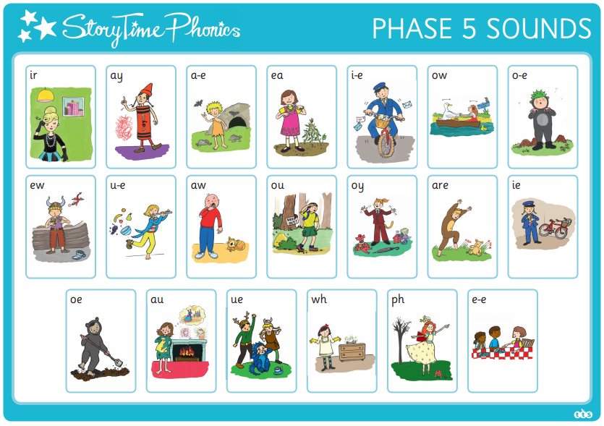
Phonics
Help your child to practice recognising these phonemes.
Look for them in books.
Can they write them in words?

Slide 11
Maths - KS1 KEY VOCABULARY / KNOWLEDGE
Operations Key Vocabulary -
Operation - Operation Addition, subtraction, multiplication or division
Number Sentence - A written calculation
SHAPES!!!
Addition - The sum of two numbers (plus, add, total, more than)
Subtraction - Taking one number away from another or finding the difference between those values
(take away, subtract, less than)
Difference Between - How many between the two numbers- often solved on a number line (how many more, how many less). Eg. Difference between 11 and 14 = 3
Multiplication - Multiplying one number by another (times, lots of, multiplied by, product of)
Array - A visual representation of multiplication
Division - Sharing or grouping a number into equal parts (share, divide, groups of, how many in)
Share - Divide a number or a number of objects equally into a number of piles
Group - Place objects in groups of a certain number
Commutative - The concept that addition and multiplication can be done in any order but subtraction and division cannot
Inverse - Reversing the effect of another operation eg 3+4=7 so 7-4=3
HOW TO HELP - Number and Place Value -
Talk to your child about Maths
Be positive about Maths and model using Maths skills
Set Maths challenges, can your child learn their 3x tables?
HOW TO HELP – Money -
Allow your child to look at different coins. Help them make different amounts with the coins available.
Allow your child to help when shopping. Can they help think about how much two items would roughly cost? Can they help in small payments? How much to give to the shop keeper and how much change they would get?
Fluency, Reasoning and Problem Solving Key Vocabulary -
Fluency - Using number and calculation skills accurately and efficiently
Reasoning - Following a line of enquiry, justifying their answers
Problem Solving - Solving real life and logical problems using mathematical understanding
HOW TO HELP - Problem Solving -
Embrace struggle! Teach your child that it’s good get stuck! This is how we learn best. Allow time for resilience building.

Slide 12
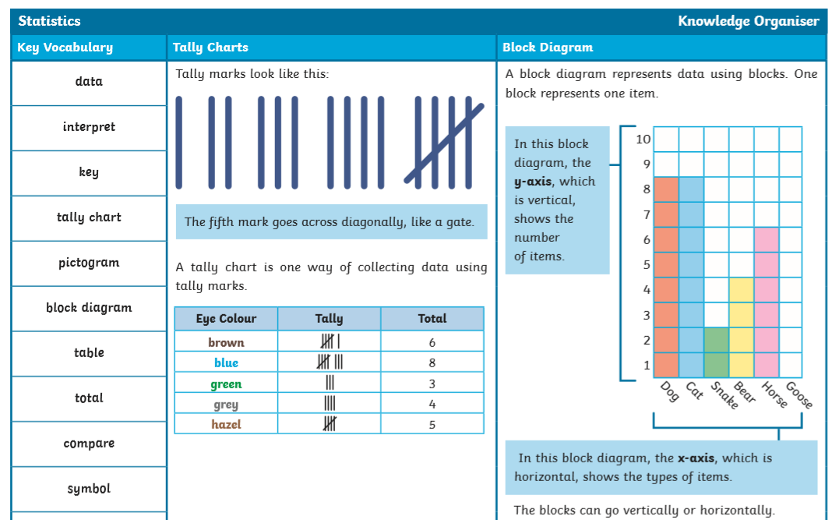
Maths - KS1 KEY VOCABULARY / HOW TO HELP - CONTINUED

Slide 13
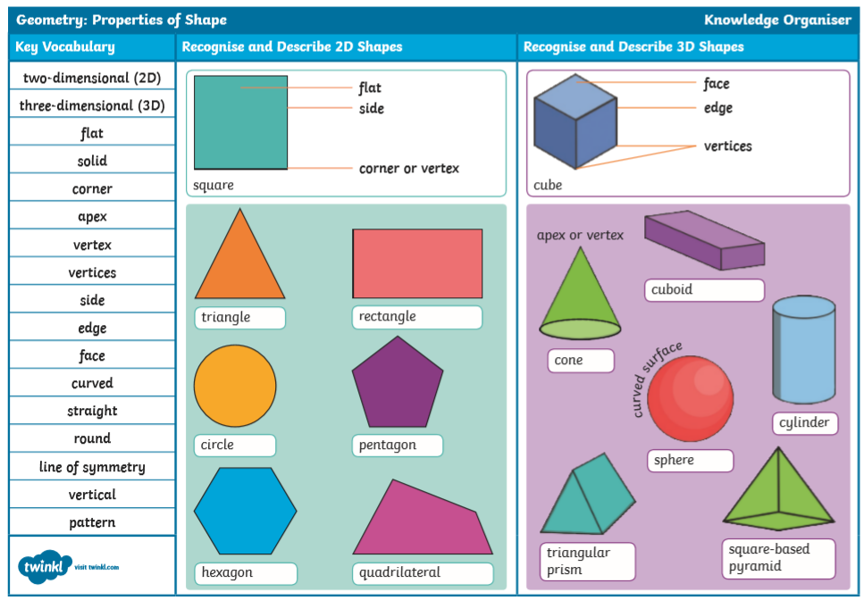
Maths - KS1 KEY VOCABULARY / HOW TO HELP - CONTINUED

Slide 14
Maths - KS1 KEY VOCABULARY / HOW TO HELP - CONTINUED

Slide 15
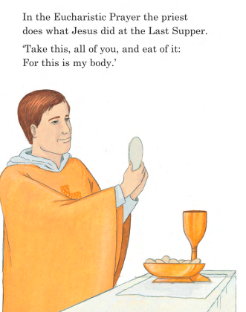
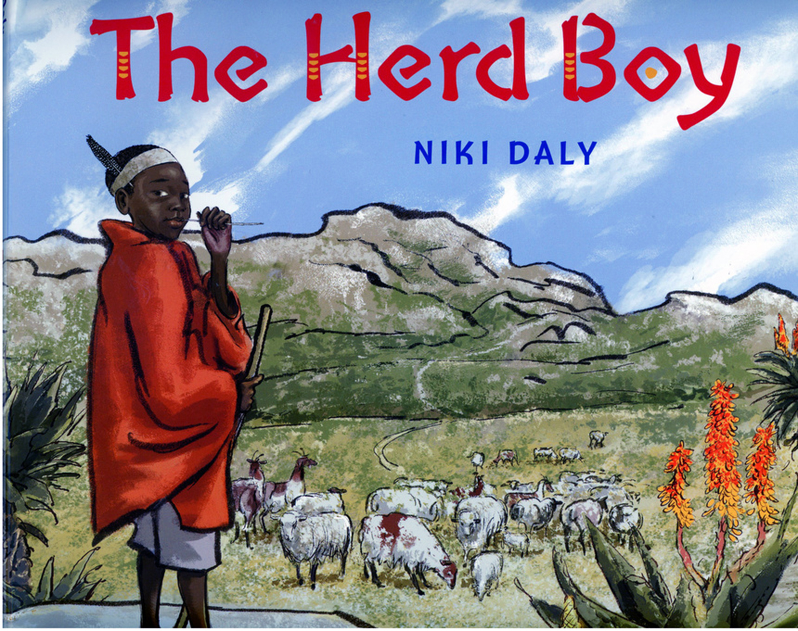
Religious Education
Eucharist / Lent
Know and understand:
About the books used at home and in school.
The books used in Church on Sunday by the parish family
Know and understand:
Different ways to say thank you.
The Eucharist: the parish family thanks God for Jesus.

Slide 16
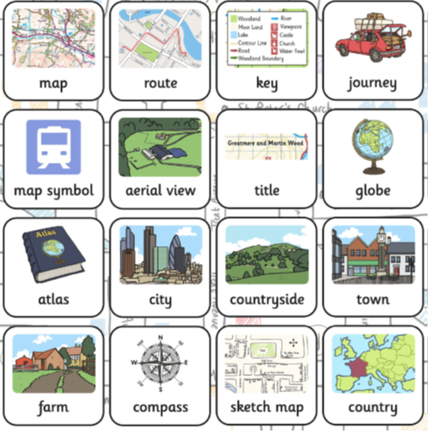
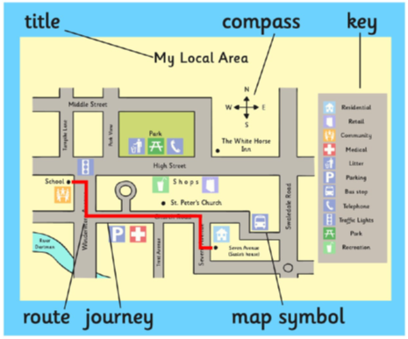
Geography
Maps and Atlases
Year 2 Skills:
Follow directions (as yr 1 and inc’. NSEW)
Draw a map of a real or imaginary place. (e.g. add detail to a sketch map from aerial photograph)
Begin to understand the need for a key.
Use class agreed symbols to make a simple key.
Follow a route on a map.
Use a plan view.
Find land/sea on globe.
Use teacher drawn base maps.
Use large scale OS maps.
Use an infant atlas

Slide 17
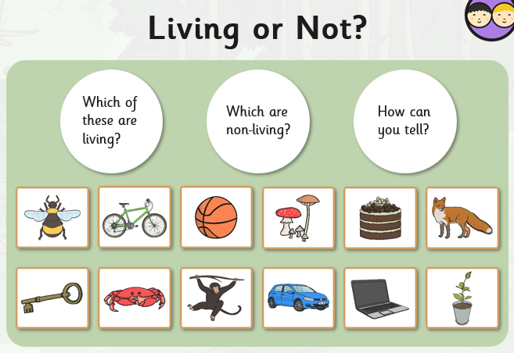
Science
Computing – Online safety and Emailing
Purple Mash
Computing
2 Email
Year 2 Skills:
Explore and compare the differences between things that are living, dead and things that have never been alive.
Identify and name a variety of plants and animals in their habitats, including microhabitats.
Year 2 Skills:
• Retrieve digital content from e mail messages.
• Organise content by making audio notes and by creating an information table.

Slide 18
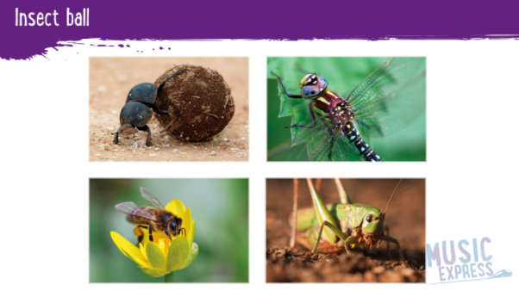
Art
Based on Henri Rousseau
Music
Year 2 Skills:
Mix a range of secondary colours, shades and tones.
Experiment with tools and techniques inc. layering, mixing media, scraping through etc.
Name different types of paint and their properties.
Work on a range of scales eg. Large brush on large paper etc.
Mix and match colours using artefacts and objects.
Manipulate clay for a variety of purposes.
Key Vocabulary :
Year 2 Skills:
Performing steady beat patterns with a song.
Playing different patterns of steady beat within four beats and matching to a simple score.
Performing and creating simple rhythms using a simple score.
Interpreting a score to perform different beat patterns.
Exploring different ways to organise music.

Slide 19
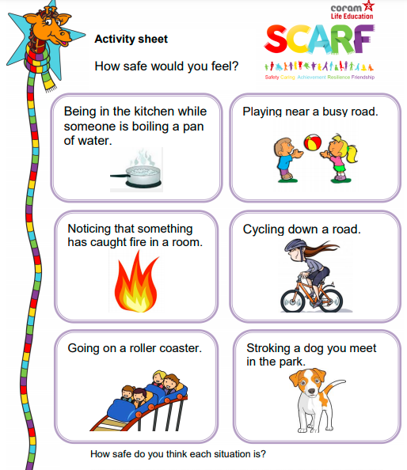
PSHE
Keeping Safe
PE - Dance
Key Questions:
What sort of boundaries are appropriate in friendships?
How to recognise and report feeling of being unsafe or feeling bad about any adult.
We will perform dances using simple movement patterns.
Year 2 Skills:
Zigzag through a series of tightly spaced markers.
Compare his/her performance with others.

Slide 20
IMPACT QUESTIONS
Science – How can you tell if something is living, dead or has never been alive?
ICT – What is a digital footprint?
Geography – What would be a human and a physical feature on a map?
Art – How can you create a number of different colours of green?
PE – How many ways can you think of to move within a performance?
Music – Can you perform a steady beat pattern?
PSHE – What is the best way to ask someone for help if you feel unsafe?

