Slide 1
Welcome to Year 4
Teacher: Mrs Kenway
Teaching Assistant: Miss Taylor

Slide 2
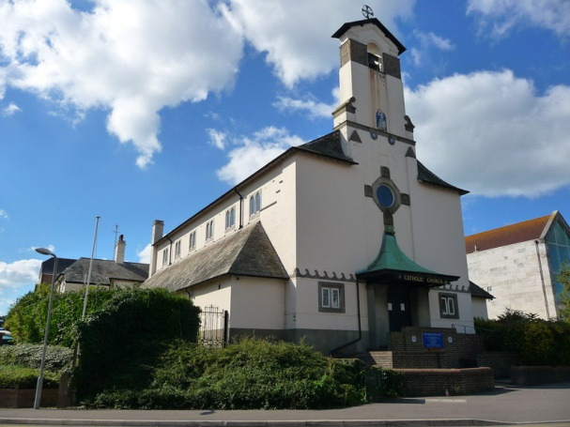
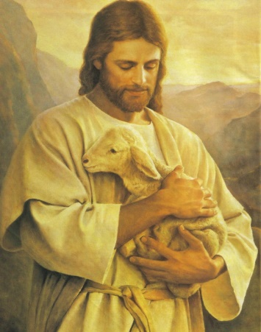
Catholic Life and Our School Mission Statement
The Catholic Life of our school is at the heart of everything we do.
Our school mission statement is our prayer.
‘Lead us Lord,
To Act Justly,
To Love Tenderly,
To walk humbly.
Amen.’
We ask the Lord to lead us in our relationships with one another and to lead us in all our work at school.
We are proud to form part of Our Lady Star of the Sea Parish and work closely with Father Stephen and Deacon Geoffrey .
Our Catholic Life encompasses our work in RE and also the Worship Life of our school.

Slide 3
Our Gospel Values
Our Gospel Values are important to the Catholic Life of our school.
They are the qualities that underpin the way we approach our life at school.
Here are our Gospel Values displayed on our school certificates.
We start each week with a whole school Liturgy and during this worship time, focus on a gospel value to incorporate into our learning during that week. The children who demonstrate the gospel values are awarded Gospel Value certificates every two weeks and their achievements in relation to the values are rewarded in Celebration assembly.

Slide 4
Laudato Si’ – On Care for our Common Home
Laudato Si-On Care for the Common Home –
An Encyclical Letter from Pope Francis on Care for our World
We find opportunities through our topic teaching and through explicit RE lessons, to learn about, explore and discuss ways to care for one another and how we as caretakers of our world can learn to care for the environment. The children are encouraged to be mindful of the way they use resources responsibly and are careful in the way they consider energy use both at school and in their own homes.
Our curriculum is designed to allow children from Reception to Year 6 to consider how we all have a responsibility to care for our home, our planet, our common home.

Slide 5
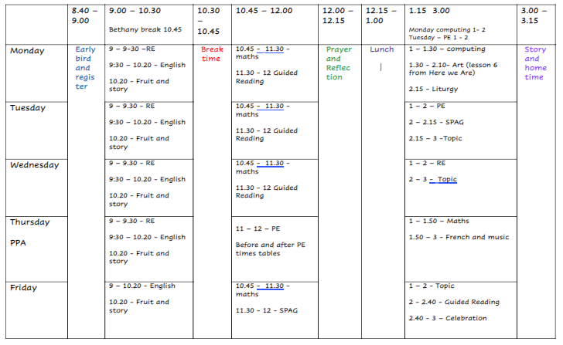
Year 4 timetable
The school day starts between 8.40 and 8.55.
PE days – Tuesday and Thursday
Every Friday, PE kits will be sent home for washing and must be returned on a Monday please
The school day finishes between 3 and 3.15pm.

Slide 6
Year 4 Topics
Term | Topic
Autumn 1 | What’s The Matter?
Autumn 2 | Disgusting Digestion
Spring 1 | Amazing Amazon
Spring 2 | Extreme Environments
Summer 1 | Rotten Romans
Summer 2 | Mummies, Mystery and Magic

Slide 7
Parents in Partnership and Home learning
PIPs and home learning will be available on the school website, in the new Year 4 tab at the top of the homepage, on a Friday and homework is expected to be back by the following Wednesday.
Home Learning English and Maths tasks will be set using an online platform called IXL.
Spellings will be included within the PIP letter.
Reading expectations – we aim for all children to be reading with an adult at least 3 times a week.

Slide 8
Reading at Home
At St Augustine’s we know that the development of reading and writing skills are of paramount importance and can impact children’s progress in reading and writing for the rest of their lives.
From the 11th September, children will be given a home reading record. On the front cover will be your child’s name and the day of the week that their books will be changed.
Your child will need to hand their book in to the box at the back of the classroom on their dedicated day. The books that they return will then be ‘held’ for 72 hours before being put back in the reading book collection.
The reading that your child does at home will impact their writing skills and
help them to see the world with leaving the safety of their homes.

Slide 9
Rewards
House Points – Each child is allocated a ‘House Team’ this maybe red, blue, yellow or green. Children can be rewarded for their attitude to learning, behaviour and how they follow our Gospel Values.
Class Pasta Jar – children will work together to earn pasta pieces to gain a class reward at the end of each half term.
Celebration Assembly - During Friday Celebration Assembly your child may be awarded a certificate for effort, achievement or attainment.

Slide 10
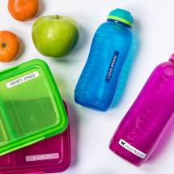
Uniform
You will see clear guidance on the school website on school uniform.
We ask that when you send your child to school in Autumn, you have every item of School uniform clearly named, including your child’s shoes.
As you can appreciate, school uniform is expensive and children need to change or take off cardigans or jumpers as they warm up. In order to make sure your child’s uniform always finds its way back to you, please name all your uniform.
School Meals, Fruit and Drinks
Whether you choose to provide your child with a packed lunch or a hot school meal, please discuss the contents of the lunch with your child to avoid upset.
We ask that you give them a named piece of fruit for morning snack.
We also ask that your child has a clearly named drink bottle with water in that they can drink from throughout the day.

Slide 11
Multiplication Check!
Please don’t panic!
June 2021
We will run a Parent Session after Christmas to inform you of all of the details

Slide 12
Communication
As you can appreciate it is extremely important for us to know the arrangements you set up
to have your child collected at the end of the day. If you know you will not be collecting your
child in person, inform us at the beginning of the day who you have arranged to collect your
child. If arrangements change during the day, please ring the school office.
The school phone number is
01305 782600.
If your child is absent, please inform us before school, either by Parent Mail or by leaving a telephone message. We need to know the reason for your child’s absence every day that they are away. Similarly, it is essential that we know of any medical conditions your child may have as soon as possible please.
Please use our new Year 4 Tab on the school website for Home Learning, letters and any other communication.

