Slide 1
Reading at St. Augustine’s
Jenny Harding
Year 5 Teacher and English Lead.

Slide 2
Why is reading so important?
Reading underpins everything.
You read and make sense of letters, words and sentences all day every day.
You read even without thinking about it.

Slide 3
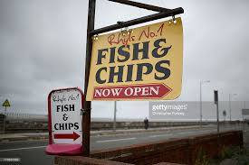
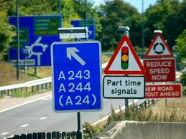
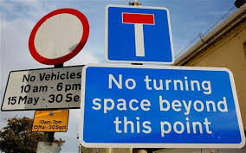
Shop and traffic signs

Slide 4
News headlines

Slide 5
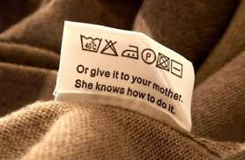
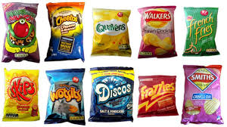
Labels on clothes, packets and bottles

Slide 6
Subtitles on TV programmes

Slide 7
But what are we actually doing when we read?

Slide 8
Reading has two components
Word Recognition (decoding)
Comprehension
To recognise words when they are in front of you.
To apply phonic rules eg. blending phonemes to decode (c-a-t)
To read words together in a sentence.
The process by which words and sentences flow together to make sense.
This process is used in understanding both the oral and written word.
It continues to develop throughout a person’s life.

Slide 9
Aims of today
To help you understand how children learn to read and the skills they need.
To give you strategies when helping your child at home.
To raise you child’s self esteem and promote reading in a positive light.

Slide 10
So why IS reading so important?
It helps children learn about the world that they live in.
It is a key skill which is needed to progress in all other subjects.
Children learn how language works and develop a love of reading.
Good writing starts with, and cannot improve without, good reading.

Slide 11
What do we do in school?
Whole class reading of a book which the teacher reads.
Shared reading as a class.
Guided reading in small groups
1:1 reading with individual children.
Independent reading.

Slide 12
How can you help your child to read?
Make it fun and relaxed.
Put aside a time when you can settle down together.
It doesn’t have to be in the evening – children are often too tired.
Try not to be disturbed.

Slide 13
Reception and KS1 children (y1 and 2)
Read to your child initially pointing to each word until your child is confident enough to join in.
Give your child the chance to read along with you.
Let your child point to the words as they read.
If your child struggles with a word, give them a chance to sound it out but don’t let them struggle for too long.
Let your child take over reading gradually – don’t push them into reading before they’re ready.

Slide 14
Questions to ask...
Find it and Prove it questions...
Find it... Jane was standing by the door wearing a red dress. Q. What colour was her dress?
Prove it... Katie took a drink out of her bag. The apple juice was cool and refreshing. Q: What was Katie’s drink?

Slide 15
More things to discuss
The title of the book.
Who is the author?
Discuss what is in the pictures.
What might happen next?
Talk about the story and the characters as you go along.
How does the character feel when ... happens?
What did you like/dislike about the story?

Slide 16
KS2 (years 3, 4, 5 and 6)
Still read to your child to show them how to read with expression.
Still listen to your child even when they are independent readers.
Spend time discussing the text.
Encourage them to read for meaning and look for the inference.
Inference is ‘reading between the lines’

Slide 17
Questions to ask to develop inference...
How does the princess feel? How do you know? What is in the text to tell you?
What do you think will happen next? Why?
Encourage your child to explain their answers and use the text to support their answer.
Eg. I think .... because, in the text, it says...

Slide 18
Also... To develop vocabulary
Can you find a word that means the same as...?
How does ‘inky, black sky’ create atmosphere? And why do you think the author used these words?
Offer an opinion to your child and give them the opportunity to contradict it and explain why.

Slide 19
Reading for pleasure... Making it fun
Visit the library and borrow books you enjoy reading together.
Choose subjects your child prefers – fiction and non fiction.
Look for words in everyday life.
Read a range of texts - newspapers, magazines, shop signs, menus, posters, cereal packets, recipes, adverts, instructions, etc, etc ........

Slide 20
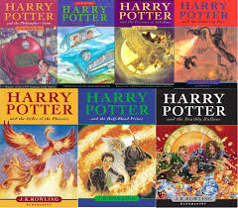
Book Recommendations...
We are currently putting together lists of the 100 books that it is recommended children should read throughout Primary School.
These lists will shortly be on our website.

Slide 21
Finally....
We appreciate that there is not always time to read.
We encourage children to read for 20 minutes a day, but ‘life’ can get in the way.
Brownies, Cubs, dance classes, football club swimming lessons etc etc.

Slide 22
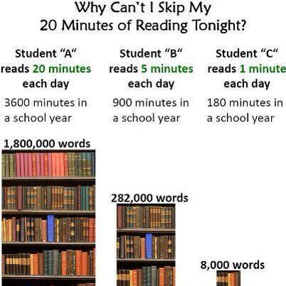
However...
As a thought provoking
final thought...
Research has
shown that ...

