Slide 1
KNOWLEDGE ORGANISER Reception

Slide 2
Curriculum Intent Statement -
At St. Augustine's Catholic Primary School, we are passionate about children's learning. The Cognitive Load research theory and Rosenshine’s Principles of Instruction highlights that children learn through remembering and recalling and this theory is embedded this within the knowledge of our curriculum.
Learning is Remembering and Recalling...
Our curriculum will be planned and sequenced around the specific vision of the National Curriculum, our Curriculum Drivers, the Laudato Si and the Gospel Values. This is based on the Catholic model that our schools have a moral purpose to help everyone and be a force for good in the world. We believe that this core belief underpins everything we do here at St Augustine's.
The curriculum will provide inspiring and relevant learning opportunities for our children to develop the knowledge and skills that can be fluently applied across all subject areas. It will ensure that all children's individual needs and experiences are developed through local, national and global contexts.
In order for children to relate to their learning, topic areas will be carefully planned for and supported through external visitors talking about their experiences, or a class trip to supplement the children's learning.

Slide 3
Curriculum Development - Intent
LauDato Si, National Curriculum and Gospel Values
Using our Secrets to Success…
Roseshines Theory
Arithmatic
Fluency
Reasoning
Problem Solving
Parents in Partnership and Knowledge Organisers
English
Reading
Writing
Phonics
Spelling
Punctuation
Grammar
Maths
RE
Knowledge and Understanding
Engagement and
Response
Analysis and Evaluation
The Culture Team
History
Geography
French (MFL)
The Arts and Technology Team
Design Technology Art
Music
Computing
The Healthy Hearts and Minds Team
PE
Science
PSHE / RSHE
Being the best we can be

Slide 4
Our Laudato Si key question this half term…
As we travel, how can we help to take care of our world? ?
Our Focus Gospel Values this half term are…
How can you spread peace?

Slide 5
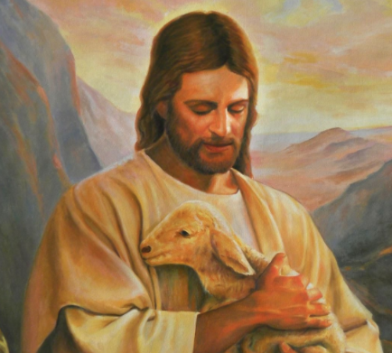
School Mission Statement
Lead us Lord,
To act justly,
To love tenderly,
And to walk humbly.
Amen

Slide 6
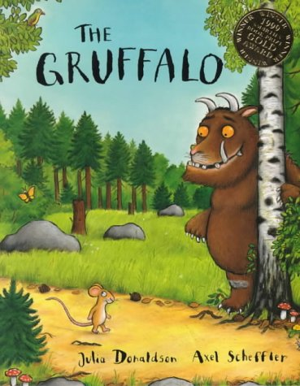
We’re going on a journey
This half term, we’re learning about taking trips and going on journeys. We will use well known stories to help us with our work and will start with the Michael Rosen book, “We’re going on a Bear Hunt” for 2 weeks and then will work on a book we have shared with reception called, “The Train Ride” and we’ll finish our work this term by journeying through the forest as we use the popular Julia Donaldson story, “The Gruffalo.” During our work, we will develop our storytelling skills and use the books to help us learn about places, travel and habitats. We have lots of exciting things planned, including:
Art work linked to colours and shade as we study the work of Henri Rousseau.
Science work linked to materials, forces and animal habitats.
Music linked to Going Places as we learn about pitch, focusing on High and Low sounds.
How you can help your child with this topic:
Talk about journeys you have been on with your child and places that your child likes to visit. Discuss what you saw and how you travelled.
Talk to your child about the stories being studied.
Encourage them to tell you about the stories and to practice retelling the stories, either using the words from the book or using their own words.
The next few slides will show you some of the things that we will be covering within specific subjects. Each subject will be developed through the topic in line with the Early Years Foundation Stage Curriculum.

Slide 7
Reception English - KEY VOCABULARY
Phonics/Spelling Key Vocabulary
Phoneme - A single unit of sound
Grapheme - A letter, or combination of letters, that corresponds to a single phoneme within a word e.g. ten
Diagraph - A type of grapheme where two letters represent one phoneme (sound) e.g. ch, sh, th etc…
Trigraph- A type of grapheme where 3 letters represent one phoneme (sound) e.g. igh, ear, air etc…
Consonants - Most of the letters of the alphabet represent consonants; the letters a, e, i, o, u represent vowels
Vowels - The letters a, e, i, o, u
Segment - Break a word into phonemes
Blend - Put the phonemes back together
Tricky Word/Common Exception Word - A word which can’t be phonetically decoded
Reading Key Vocabulary
Decoding - Breaking down a word into different phonemes to help read it
Prediction - Saying what will happen next or as a result of something
Comprehension - Understanding what has been read
Inference - Making assumptions about what is happening in a text
Don’t forget to continue the Reading Challenge!
Grammar Key Vocabulary
Adjective - Used before a noun to make the noun’s meaning more specific e.g. tall, blue
Noun - Nouns are sometimes called ‘naming words’ because they name people, places and ‘things’ e.g. table, hotel
Verb - Verbs are sometimes called ‘doing words’ because many verbs name an action that someone does e.g. run, cook

Slide 8
English – Knowledge
HOW TO HELP - Reading -
Read a range of books to your child
When your child reads to you, help them focus on short words and look for the letters that you know they have recently worked on at school.
Visit the Reading Planet website and use your child’s log in details to help them read the books that we have allocated to them helping to develop enjoyment of ebooks and a love of reading.
Read comics/magazines
Let your child see you read
Make reading enjoyable and let children share books that interest them
HOW TO HELP - Phonics/Spelling –
Regularly share your child’s phonics book with them to help them revise previously taught phonemes.
Please use the Phase 2, 3 and 4 ‘Tricky Word’ lists that are provided in this presentation and are also referred to as Common Exception Word (words which can’t be phonetically decoded). We list the focus words for each week in our Google Classroom Phonics task.
Practise blending phonemes to help your child read decodable words.
Please refer to the Storytime Phonics Sounds Mats on the following slides to help your child go over all their phonemes.
Help your child be a ‘letter spotter’ as you work with them on looking for particular letters in the books you share.
Use magnetic letters or letters written on small pieces of paper/card. Help them find the letters they need to spell a particular word. You could try to help them spell their name or a decodable 3 letter word.
HOW TO HELP - Writing
Practise correct letter formation. Please look at the slide with our letter families.
Don’t over correct independent writing- aim for enthusiasm
Provide a range of writing opportunities at home with a range of writing implements such as pencils, pens, felt tips, chalks, paint, water.
Let your child see you writing
Where possible, help your child write for a purpose, e.g. Letters, Postcards, Invitations, etc

Slide 9
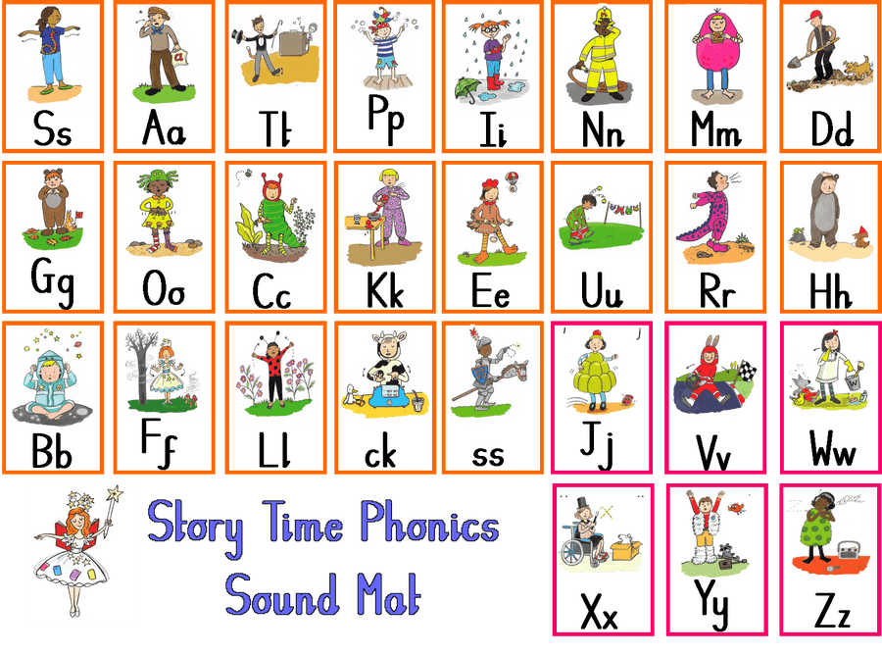
Phonics
This half term, we are revisiting all the phonemes we have taught and will be focusing on spelling as well as reading words containing these phonemes.
Help your child to practice recognising these phonemes.
Look for them in books.
Try spelling words containing these phonemes with your child, encouraging them to read and write them.
Remember to use the games on the following website to help develop your child’s reading and spelling skills.
http://www.letters-and-sounds.com/phase-3-games.html

Slide 10
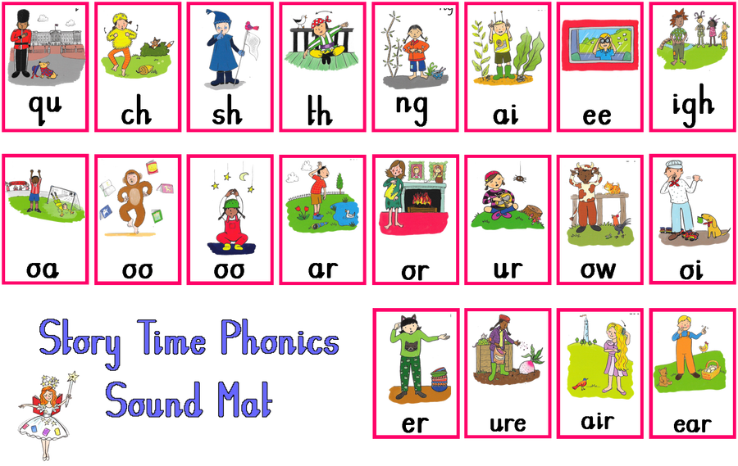
Phonics
This half term, we are revisiting all the phonemes we have taught and will be focusing on spelling as well as reading words containing these phonemes.
Help your child to practice recognising these phonemes.
Look for them in books.
Try spelling words containing these phonemes with your child, encouraging them to read and write them.
Remember to use the games on the following website to help develop your child’s reading and spelling skills.
http://www.letters-and-sounds.com/phase-3-games.html

Slide 11
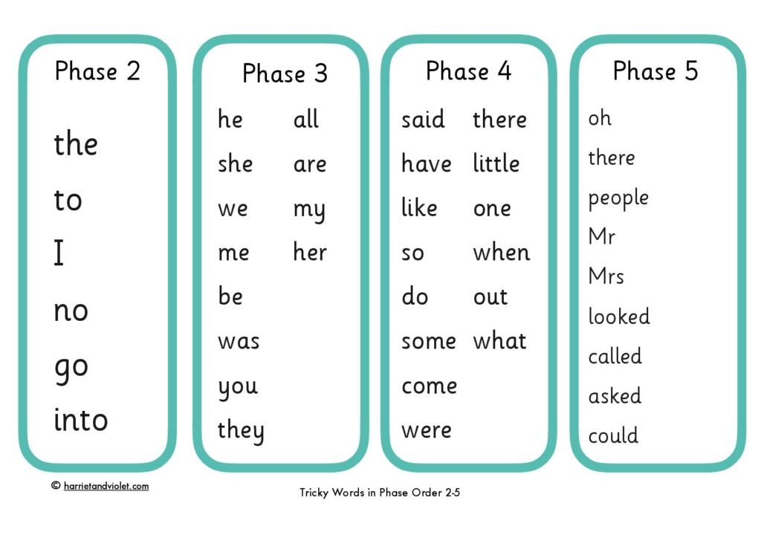
Reading
This half term, we are continuing to focus on reading Phase 2 and Phase 3 Tricky words and will be moving on to reading Phase 4 words.

Slide 12
Handwriting
This half term, we are continuing to work on pre-cursive letter formation and will be working on the Long Ladder Letters and One Armed Robot Letters.

Slide 13
Reception Maths - KEY VOCABULARY
Number Vocabulary
Greater/More Than > - When a number has a higher value than the one it is being compared with or when a group of objects has a larger quantity than the group it is being compared with.
Less than < - When a number has a lower value than the one it is being compared with or when a group of objects has a smaller quantity than the group it is being compared with.
Equals = - Use to show that both sides of a number sentence are balanced (eg. 3+4=7. 7=3+4, 2+5=3+4) or that two groups of objects contain the same amount.
Part/Part Whole Model - A way of working that teaches the children that a whole number can be made up of 2 smaller parts and that a whole number can be split into 2 smaller parts (a diagram of the Part/Part Whole Model is provided on a following slide.)
Adding- to join (something) to something else so as to increase the size, number, or amount.
Subtracting- to take away (a number or amount) from another to learn the difference.
Doubling - Adding a number or quantity of objects to itself.
Halving- Sharing a number or quantity equally between 2 groups
Number Bonds To 10 - All of the pairs of numbers which add to 10 (3+7, 4+6)
10s Frame - Used to solve addition and subtraction problems
Bead String - Used to solve problems within 100
Digit - An individual figure within a number (eg 1, 2)
Ordinal Number - Numbers which define order (1st, 2nd, 3rd)
Share - Share a number or a number of objects equally into a number of groups
Group - Place objects in groups of a certain number
Number Sentence - A written calculation

Slide 14
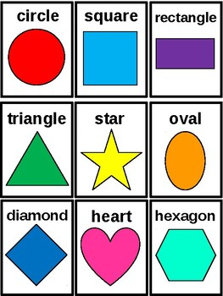
Reception Maths - KEY VOCABULARY
Shape, Space and Measures Vocabulary
2D Shapes - Flat shapes, shapes with two dimensions, such as width and height.
3D Shapes – Solid shapes, 3D shapes are shapes with three dimensions, such as width, height and depth.
Weigh- To find out how heavy (someone or something) is,using standard measures (scales)or non standard measures (cubes, conkers etc…)
Measure –a way of learning the size, amount, or degree of something.
Compare –to estimate, measure, or note the similarity or dissimilarity between objects or numbers.
Order –putting things into their correct place following a specific rule.
Sequence- a list of numbers or objects in a special order.
Capacity-the amount that something can hold.
Time-the ongoing sequence of events taking place. The past, present and future. The standard units of time are seconds, minutes, hours, days, weeks, months and years.
Prepositions-Positional words to describe the placing of an object in relation to another object. Prepositions include above, below, next to, in front of, in between etc…
Fluency, Reasoning and Problem Solving Key Vocabulary -
Fluency - Using number and calculation skills accurately and efficiently
Reasoning - Following a line of enquiry, justifying their answers through discussion
Problem Solving - Solving real life and logical problems using mathematical understanding

Slide 15
Maths – Knowledge
HOW TO HELP – Shape, Space
and Measures –
Let your child see you measure ingredients to make a cake, perhaps using weighing scales or let them help use measure water/milk needed for baking.
As the children help, explain why we need to measure so that the children can again see maths being used in a real life context.
Develop comparative language
with your child as you discuss
items being:
Talk about time and the words: morning, afternoon, evening, night, later, earlier, before. Look at a clockface and discuss how clocks measure time.
HOW TO HELP - Number -
Count regularly with your child forwards and backwards initially to 10 and then to 20.
Count objects such as bricks, toys etc…
Count actions such as steps, jumps etc…
To develop your child’s one to one correspondence and sharing skills, help your child set the table. This will help them understand that each person needs 1 of each utensil and will help them with fair sharing.
Look for numbers everywhere. By looking for numbers, the children will come to appreciate the importance of numbers in everyday life, so numbers inside such as on clocks, on cookers, washing machines, dishwashers etc.. And out in the garden or on the streets such as on front doors, car number plates, buses, bus stops etc…
Play simple board games such as Snakes and Ladders. This will help your child with sharing fairly as they take turns and also with counting and number recognition.
Please continue to use IXL games that directly link with the mathematics work we focus on each week at school.
big | bigger | biggest
long | longer | longest
heavy | heavier | heaviest
full | fuller | fullest
HOW TO HELP - Problem Solving -
Set your child practical activities to develop their skills.
I have 6 apples and 3 teddies. Please can you help me share them.
I need to work out how many bricks I have in these 2 towers. Show me how I can work this out.
Teach your child that it’s good get stuck! This is how we learn best. Allow time for resilience building.

Slide 16
Maths-Number

Slide 17
Maths-Number

Slide 18
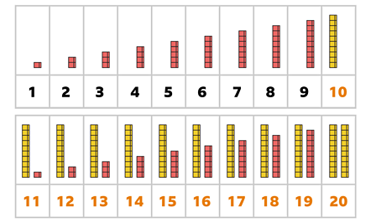
Maths-Number

Slide 19
Maths-Number

Slide 20
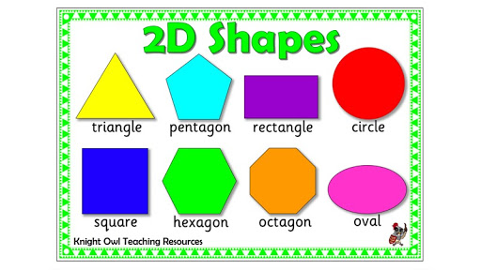
Maths – Shape, Space and Measures

Slide 21
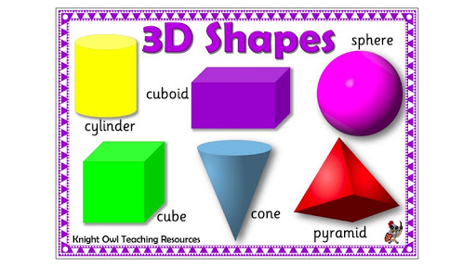
Maths – Shape, Space and Measures

Slide 22
Religious Education
Local Church-Community-Celebrating
Celebrating-People celebrate with the parish family
Church Priest Celebrate Celebrating Parish family Family Community Celebration Party Memory Father Altar
Key Words
Key Questions What is a celebration? How do people celebrate?
Temple
Parish
Some children will begin to recognise the story of Mary and Joseph taking Jesus to the Temple.
Some children will begin to recognise some of the elements and words used in church celebrations.
Some children will begin to recognise that the church/parish family celebrate in particular ways.

Slide 23
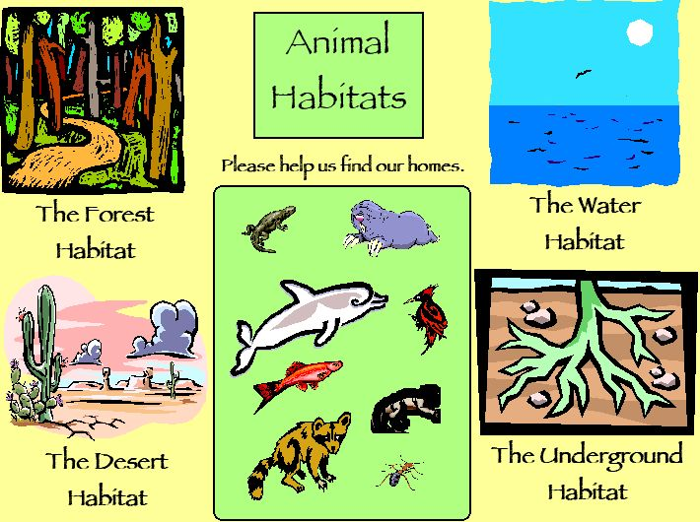
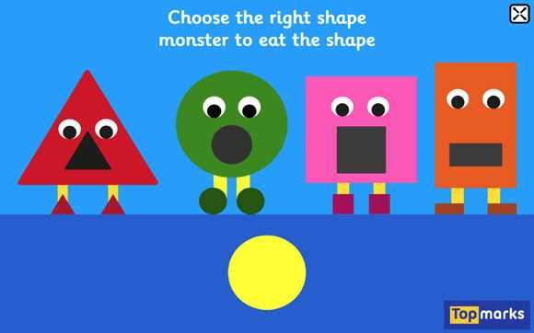
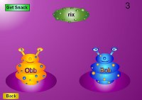
Science-The World
ICT – Technology
Reception Focus: (Understanding the World-The World)
To look closely at similarities, differences, patterns and change.
Reception Focus: ( Understanding the World-Technology)
• To complete a simple program on a computer.
• To use ICT hardware to interact with age‐appropriate computer
We will continue to
Look at seasonal
changes in the
outdoor environment.
Key words.
seasons
Autumn
Winter
Spring
Summer
change
We will work on age appropriate software that helps complement the children’s learning in other curriculum areas developing their use of touch screen technology.
We will learn about animals and where they live as we learn about habitats.
Key words
Animal names
Water/ocean/sea
Forest/woodland
Desert/dry
Underground
Home/Habitat

Slide 24
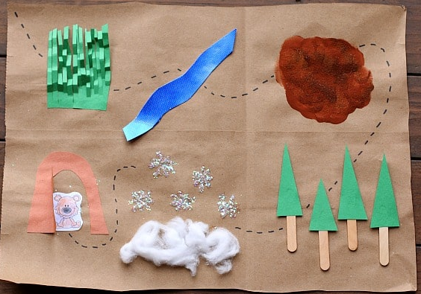
Geography-Places
Reception Geography Focus: (Understanding the World-
The World)
To look closely at similarities, differences, patterns and change.
We will link our work to Science as we study environmental geography and vocabulary linked to habitats and geographical features in the outdoor environment.
Key Words
Places
Grasslands
Rivers
Muddy swamps
Forests
Snowlands
Caves
.
Story Map linked to “We’re Going on a Bear Hunt”
As we travel, how can we help to take care of our world? ?
Our geography work will link to our Laudato Si question-

Slide 25
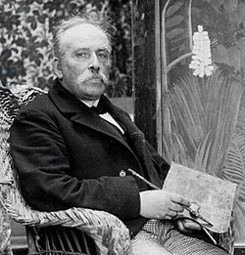
Art-Habitats
Music-High and Low Sounds
Reception Art and Design Focus: (Expressive Arts and Design-Exploring and Using Media and Materials and Being Imaginative)
Reception Music Focus: (Expressive Arts and Design-Being Imaginative)
We will focus on habitats this half term and will focus on the work of Henri Rousseau as we look at colour and shade and create our own pieces based on Henri Rousseau’s ‘Tiger in a Tropical Storm.’
We will focus on a unit called Going Places to link with our topic on We’re going on a Journey. During our work we will play musical games using body percussion and untuned percussion to help us learn about pitch and high and low sounds.
Key Words :
Paint
Pastels
Pencils
Pens
Lines-straight, curved,
zig zag
Shapes
Colour
Shades
Blending-mixing
Key Words
• Beat
Steady
Fast/faster
Slow/slower
Lively
Calm
Soft
Rhythm
Tempo
Pitch
High
Low

Slide 26
PSHE-Valuing Difference
Reception Focus:
(Personal, Social and Emotional Development-Making Relationships)
PE-Ball Skills
Reception Focus:
(Physical Development-Moving and Handling and health and Self-Care)
Ball Skills
We will focus on
General Movement and Coordination as we work on developing our ball skills.
We will continue to develop independent skills in learning to dress for PE.
We will focus on the awareness of the effect of exercise on our bodies and related to this, the need to rehydrate after physical activities.
We will focus on understanding that we are all special and we will learn that we share similarities with our friends and we will learn that we are also different. We learn to appreciate and understand our differences.
Key Words :
Move
Jump
Walk
Hop
Run
Speed
Direction
Play
Stop
Roll
Throw
Catch
Key Words :
Care
Kindness
Understanding
Patience
Help
Same
Different

Slide 27
Foundation Subject IMPACT QUESTIONS
Science-The World
What are the names of 3 animal habitats?
Can you play a game on the computer that helps you with your phonics and reading?
What are the names of 3 places that you like to visit?
Can you use colour and shade to create a picture of a place?
Can you use your voice to make a high sound and a low sound?
Name one way that your friend is special and similar to you and one way that your friend is special and different to you.
Can you roll a ball and stop it.
ICT – Technology
Geography-Places
Art-Habitats
Music-High and Low Sounds
Art and DT.
PSHE-Valuing Difference
Music
PSHE
PE-Ball Skills
PE

